Slide 1
Animal husbandry and feed industry
State, Trends, Outlook
Papp Gergely

Slide 2
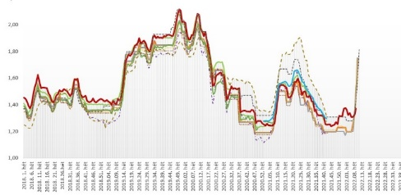
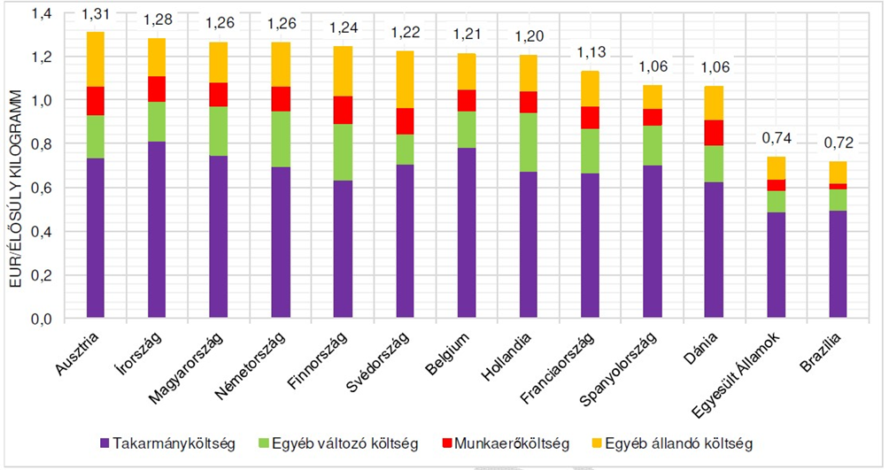
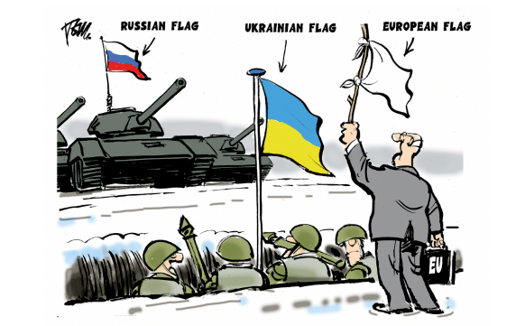
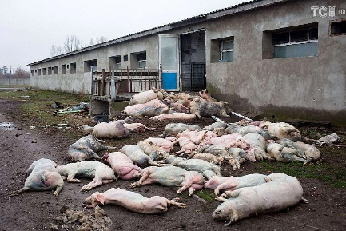
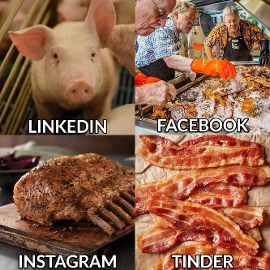
War in Europe☹
High and increasing production costs ☹
Epidemic animal deseases
Drought
COVID ???
Labor problems
EURO exchange rate
Notes:
Very high - compared to two years ago double/triple feed and feed supplement prices. Price is one thing - but not always available or not always sold, there are several speculations
Increased energy prices (depending on contract-time: electricity: 3x-4x, gas 6x-10x) In the case of fuel, not only own use, but also increased costs for various transport (input, livestock)! (+20%)Investment related input costs - construction, equipment, raw materials - have also increased. Implementation of successful tenders may be at risk - Risk and spread of African swine fever in Europe. - High prevention and control costs - Inflation - Forced increase in wages - DAILY COST CHANGES!
At the end of 2021 Hungary has successfully completed the PRRS eradication programme, all the farms are PRRS free. This and related results will be very important in reducing the use of antibiotics.

Slide 3
The effects of the Russian-Ukrainian war
Two important grain producers are at war: Ukraine and the Russian Federation together account for about 30 percent of the world's grain exports. In addition to wheat, Ukraine is one of the largest exporters of barley, corn, sunflower and other oilseeds. (if the Black Sea ports are operating)
Russia is a very significant fertilizer exporter. Disruptions in Russian fertilizer exports, as well as rising oil and gas prices, strongly increase fertilizer and food prices.
Because of these, the war also threatens global food security (not in the EU, but in developing countries). According to the FAO, the number of hungry people in the world may increase by 8-13 million people.
Not only does production become more expensive, but due to the rising costs of households, purchasing power also decreases throughout Europe.
Notes:
Ukrajna a napraforgómagolaj fontos forrása egyben, a világpiac mintegy 50%-át adja. Az USDA 2021/2022-ben 33 millió tonnára becsülte Ukrajna búza termelését, exportját pedig 24 millió tonnára. Ezzel Ukrajna a harmadik legnagyobb búzaexportőr lenne idén, közel 12%-os részesedéssel a globális búzapiacon. Minezek az adatok azonban nem számolnak a háború következtében bekövetkező termelési és szállítási nehézségekkel. A 2021/22. gazdasági évben az USDA szerint 42 millió tonna kukoricát termel, amelyből 33,5 millió tonnát szánnak exportra. Ezzel Ukrajna a globális kukoricaexport mintegy 17%-át tette volna ki, és a világ negyedik legnagyobb kukoricaexportőre lenne.

Slide 4
Inputprice-explosion
In Europe, the energy market crisis is also caused by the "boycott" of Russian energy carriers, the costs of not only livestock farmers, but also food processors have increased by orders of magnitude.
The rise in feed prices has already started in the last two years. The lack of fodder grains and oilseeds lost from the European market due to the war clearly affects the animal species that eat graing (primarily pigs and poultry) the most sensitively...
It is questionable whether, in such an inflationary environment, animal breeders and food processors will have a chance to pass on this price increase?

Slide 5
Epidemic Animal Deseases
ASP, bird flu
Due to the African swine fever present in the wild boar population in our country since 2018, as well as the recurring bird flu, we are losing out on well-paying export markets.
Due to the spread of diseases in the EU, competition has increased in the internal market. In such circumstances, it is difficult to make the advantage that we provide high-quality, grain-based feed in these sectors pay for.
The solution is clearly to increase biological safety with good practices, discipline and targeted epidemic prevention investments.

Slide 6
Livestock farmers are the real losers of the drought 1.
This year, the vast majority of the country's territory was hit by a severe or high degree of drought. In addition to the losses experienced by the grain growers, a significant part of the corn crop was also destroyed, and our lawns were also burnt.
The unprecedented drought does not only cause problems for plant growers. Livestock breeders are clearly the most endangered, since - in addition to the fact that last year was not successful for them either - the lack of fodder due to the drought in some places is so great that they will not be able to winterize their livestock without help.
The problem is so complex that it cannot be solved simply by modifying the feed recipes - which will result in a decrease in efficiency anyway.
And in some livestock sectors - just think of pond farms and fish farming - not only the price increase and availability of feed and other input materials cause problems, but the animals' habitat is also at risk.

Slide 7
Livestock farmers are the real losers of the drought 2.
We are receiving news from several sectors about the decrease in slaughter weights, the reduction in the number of inseminations, and the number of advertisements for breeding animals for sale has increased. The signs already indicate that the number of domestic livestock will decrease, but the extent cannot yet be predicted.
It must be clearly seen that those who end up keeping animals in their dire straits will probably never start again.
It is likely that the decline will be temporary in several sectors: other, more efficiently producing economies will take over part of the lost production

Slide 8
Animal husbandry position
Agriculture, including animal husbandry, is a strategic sector in Hungary: strong agriculture is unimaginable without animal husbandry and the production of animal products based on it.
Both grain and fiber fodder are suitable for the adequate quality of fodder for livestock, which is one of the foundations of competitiveness.
Despite this, after the change of regime, the biggest decline in agriculture occurred in the animal husbandry sectors, many of them completely switched to the more profitable cultivation of field crops.
The share of animal husbandry, which used to determine the entire gross agricultural output, has now dropped below 35 percent.
 | Plant production | Animal husbandry
2015 | 58,2% | 34,8%
2016 | 60,0% | 33,0%
2017 | 58,0% | 34,8%

Slide 9
Animal husbandry position
Currently, domestic livestock breeding is stagnating despite the subsidies provided to the sector, while the sector has significant untapped potential.
In order to make much better use of the dormant production potential in the sector, continuous development and the practical application of domestic and international innovations are essential.
More extreme weather due to climate change, epidemic animal diseases, growing social expectations - such as animal welfare and environmental protection - and limited resource bases pose ever-increasing challenges to the sector, so animal husbandry and food production based on it must meet greater demands than ever before.
Our goal is to meet the challenges,
Standing on strong feet in Hungary both professionally and administratively,
be a well-organized and profitable animal husbandry.

Slide 10
Threats and opportunities…
Threats and opportunities - challenges and prospects
With the correct recognition of trends and problems, professional collaboration and influencing/developing farming - and its conditions - the changes taking place around us can not only be a threat but also an opportunity
Each livestock sector is subject to independent analysis, but there are common problems and similar solutions may exist

Slide 11
The Human factor…
Labor shortage
Education, training
One of the most pressing issues in animal husbandry is the labor shortage, even for jobs that do not require professional qualifications, but only training.
The lack or inadequacy of secondary vocational training is a serious problem.
One of the keys to reducing the labor shortage, which we talk about less, is the creation of decent working conditions and treatment, which would be the employer's task and only partially depends on the employer's financial capabilities. We have to help employers and employees in creating and launching them in Hungary (by presenting good practices, building career models, etc.)
Basically, two types of training are needed on the animal husbandry side, which would provide skilled sector workers and technicians with appropriate specialization. All other more "sophisticated" solutions overcomplicate and make training more expensive:
Animal breeder vocational training on a full-time basis
Animal breeding technician qualification supplemented with advanced theoretical foundations and high school diploma.
Obtaining additional qualifications as part of OKJ courses (beekeeper, farrier, etc.)
The restructuring of higher vocational education will soon take place, in connection with which we consider it important to set up a mandatory practical training system for the teachers participating in agricultural education.

Slide 12
Development and R&D programs
State
Tasks
As a result of the modernization that can also be felt in the agricultural and food economy, today's research, development and innovation activities are expected to open up opportunities that are completely separated from the current production technologies, structures and raw materials.
Research and development expenditures in Hungary are currently at a low level compared to other EU member states, which hinders the competitiveness of the agricultural sector.
Not all research institutions have the appropriate research infrastructure, but the lack of researchers and inadequate agricultural training also make the situation worse.
Research that improves competitiveness and can be implemented with limited financial resources
Development of research workshops, encouraging cooperation between institutions and professionals
Genomics - genomic breeding value estimation
Introducing precision breeding
Effective implementation of a protein program
Creation of a lawn action plan and lawn cadastre
Collection, processing and sharing of good husbandry and animal health practices
Reduction of ammonia emissions
Antimicrobial resistance research

Slide 13
Market access measures
Tasks
Successful animal husbandry cannot be imagined without well-structured and implemented marketing programs, which, in addition to advertising the products produced during the production of goods, also facilitate the access of breeding animals to the market.
Coordination of agricultural marketing activities
Launching market research and marketing programs to help farm animals and animal products reach the market
Targeted support for breeding animal exhibitions
Transformation of OMÉK into a profession-focused event
Preparing companies for market activity, including foreign market activity (market information, product training, financing)
Development of a support system for financing PR and marketing costs

Slide 14
Animal health status
Importance
Tasks
Improving the animal health status of livestock is one of the key issues of our competitiveness.
The subclinical presence of diseases significantly impairs the efficiency of production, which causes considerable economic damage to livestock keepers.
In order to prevent diseases, improve animal health status and increase animal welfare, steps must be taken at the sector level.
These measures are also important for the purpose of increasing the recognition of Hungarian livestock breeding and domestic consumption
Good animal husbandry, animal health and epidemic prevention practices
Priority protection against recurrent and highly damaging animal diseases (ASP, bird flu)
Confirmed reorganization of the official veterinary service
Review and completion of ongoing exemption programs (PRRS, IBR, leukosis, brucellosis, etc.), maintenance, initiation of new ones
Continuous publication of animal health requirements, activities and results to farmers and consumers in order to strengthen trust.
Humans (consumers) as a vector of some animal diseases: awareness and prevention

Slide 15
Policy of subsidy
In the current support structure, without EU funds, three-quarters of domestic farmers would be unprofitable. In the future, it is necessary to move away from this state so that these resources are used by producers to improve their competitiveness instead of survival.
Instead of a quantitative approach, a qualitative approach should be enforced in the support policy. The way to do this is e.g. separation of animal-based subsidies into basic subsidies for commodity producers and advanced subsidies for livestock producers.
Providing high-level national resources to animal breeders.
The possibility of subsidizing the poultry and pig sectors must be reconsidered and resolved.
Continuation of investment subsidies, paying special attention to developments that promote and encourage the use of technologies and husbandry methods that increase animal welfare and reduce environmental impact.
Priority national co-financing of rural development subsidies is a huge opportunity that must be exploited
Encouraging investments in the manufacturing industry (also with additional resources) in order to produce domestic products to the highest possible degree of processing (even ready-to-use and convenience products).
In order to produce marketable products, market research related to market access measures is important.
Supporting young farmers and the generational change remains of paramount importance
Creating a regulatory environment aimed at speeding up the assessment of Rural Development Tenrers applications and bank loans. (The long evaluation times also mean serious uncertainty and financing problems for some actors.)

Slide 16
Adequate regulatory environment
Taxation
Income security
Maintaining the state's assumption of official fees affecting animal breeders and the processing industry.
VAT reduction: continuation of the VAT reduction of live animals and basic foodstuffs to 5 percent.
Reducing the employer's contribution for livestock workers (so that the savings can be paid as wages)
A complex system must also be developed and launched in the animal husbandry sector, which, in addition to service-oriented insurance, creates the basis for the self-care of producers and processors and the income security of workers in the sector.
The renewal of premium-subsidized pet insurance and the establishment of a self-care fund based on it and operating alongside it.
It is essential to develop and launch a complex risk management system in the livestock and processing sectors.

Slide 17
Social pressures on animal production pathways and their products
The ecological footprint of animal husbandry
Scandals (counterfeit products, fraud, black economy, animal diseases)
A false image of the conditions of animal husbandry and its increasingly strict regulation
Oversizing the health problems associated with (excessive) meat and milk consumption
The rise in popularity of veganism
Growing expectations of the countryside, contrast between countryside and city
Ignorance of modern technology procedures, their misunderstanding.
Stricter regulation of transport conditions
Modification of certain rules related to animal health procedures
Expectations related to the intoxication technologies used before slaughter

Slide 18
Consumer reservations and expectations related to animal product lines and their products
The production conditions must be ethical and animal-friendly, and the consumer can be convinced of this.
The ecological footprint of production should be as small as possible.
The product should be healthy, with as few additives as possible.
The product should be fresh, but maintain its quality for as long as possible.
The product must be safe.
The product should be tasty.
Preparation of the product before consumption should take as little time as possible.
The possibility of full information about the ingredients of the product and the method of production should be provided.
The geographical origin of the product's raw materials should be known.
The product range should give you the opportunity to meet the needs arising from different lifestyles (religious, health-based needs, etc.).
The product should be cheap.
Both animal husbandry and processing companies and their products must meet these expectations in order to be successful in the market.

