Slide 1



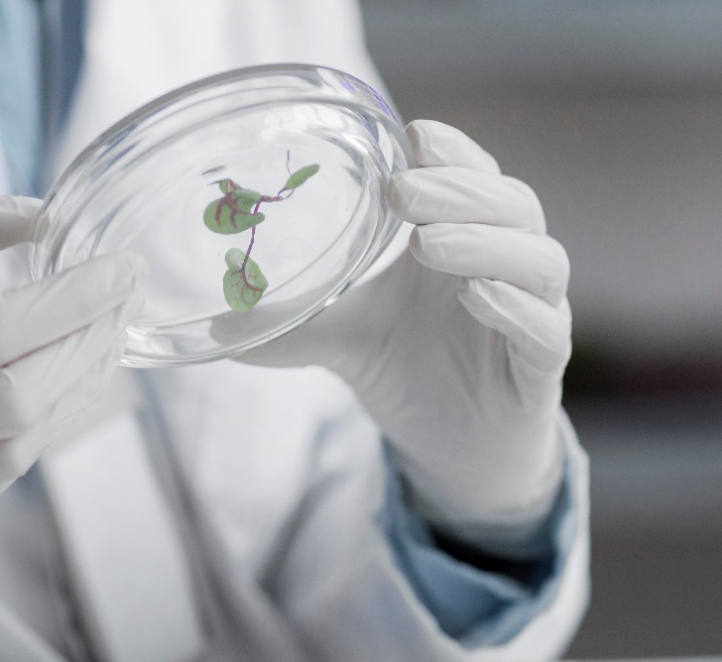
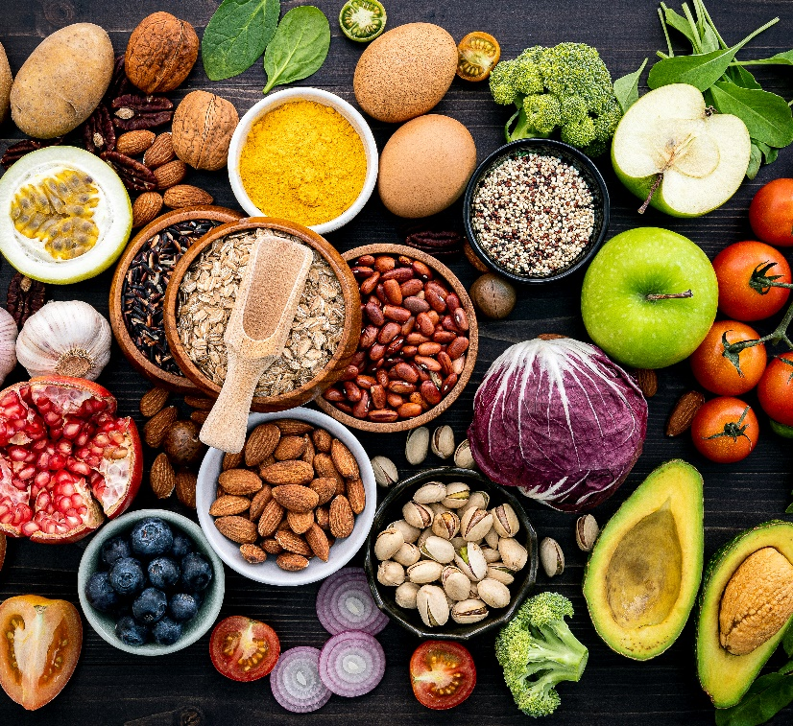

Royal DSM
A global purpose-led
science-based leader in
Health, Nutrition & Bioscience

Slide 2

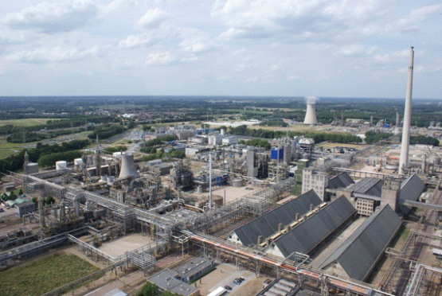
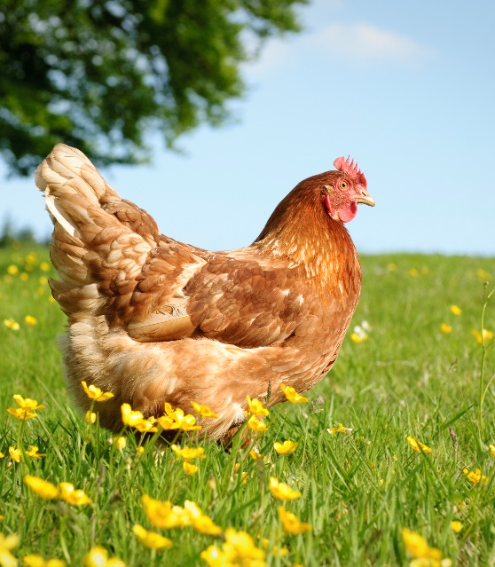





More than a century of successful transformation
Coal mining
(Petro)chemicals
Nutrition, Health
& Sustainable Living
Health, Nutrition,
& Bioscience
2022
1902

Slide 3
Today’s global leader in Health, Nutrition & Bioscience
Other (12%)
Food & Beverage
Solutions (12%)
Electrical/
electronics (5%)
Net Sales*
€9bn+
Automotive/
transport (7%)
Dietary
Supplements (12%)
Early Life
Nutrition (5%)
Rest of the world (3%)
The Netherlands (4%)
Rest of Asia (16%)
Switzerland (2%)
Medical
Pharma (6%)
Net Sales*
by region
Animal Nutrition (36%)
Personal
Care (5%)
China (13%)
Rest of Europe (28%)
Latin America (13%)
North America (21%)
* Based on continuing operations, full year 2021

Slide 4


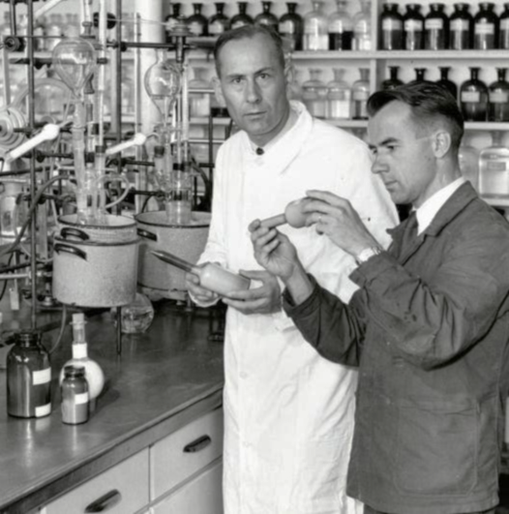
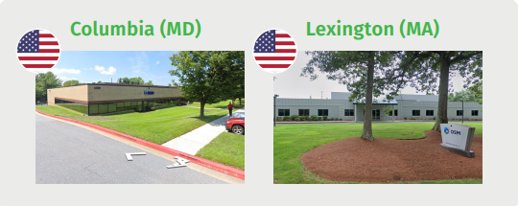
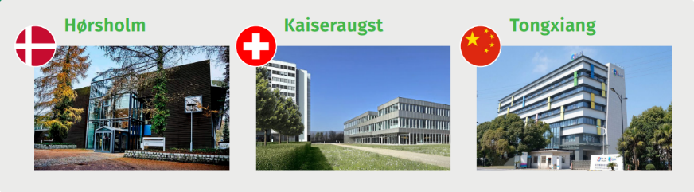
150 years of scientific heritage with worldwide facilities
1869
1930s
Today
Gist- en Spiritusfabriek
First yeast and enzyme
production at scale
(DSM acquired Gist-Brocades in 1998)
F. Hoffmann-La Roche
First chemical synthesis
of vitamins
(DSM acquired Roche Vitamins & Fine Chemicals in 2003)
~1,500 scientists in 35 research laboratories worldwide
Some of our bioscience research centers around the world

Slide 5






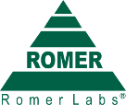






Scientific leadership enhanced through high quality M&A
2011
2012
2013
2014
2015
2017
2018
2019
2020
2021
Strengthened bioscience capabilities and expanded global geographic reach
Adding new product categories and creating the most comprehensive portfolio of nutritional solutions
Building a unique business model with solutions/premix and extending this into precision and personalization

Slide 6
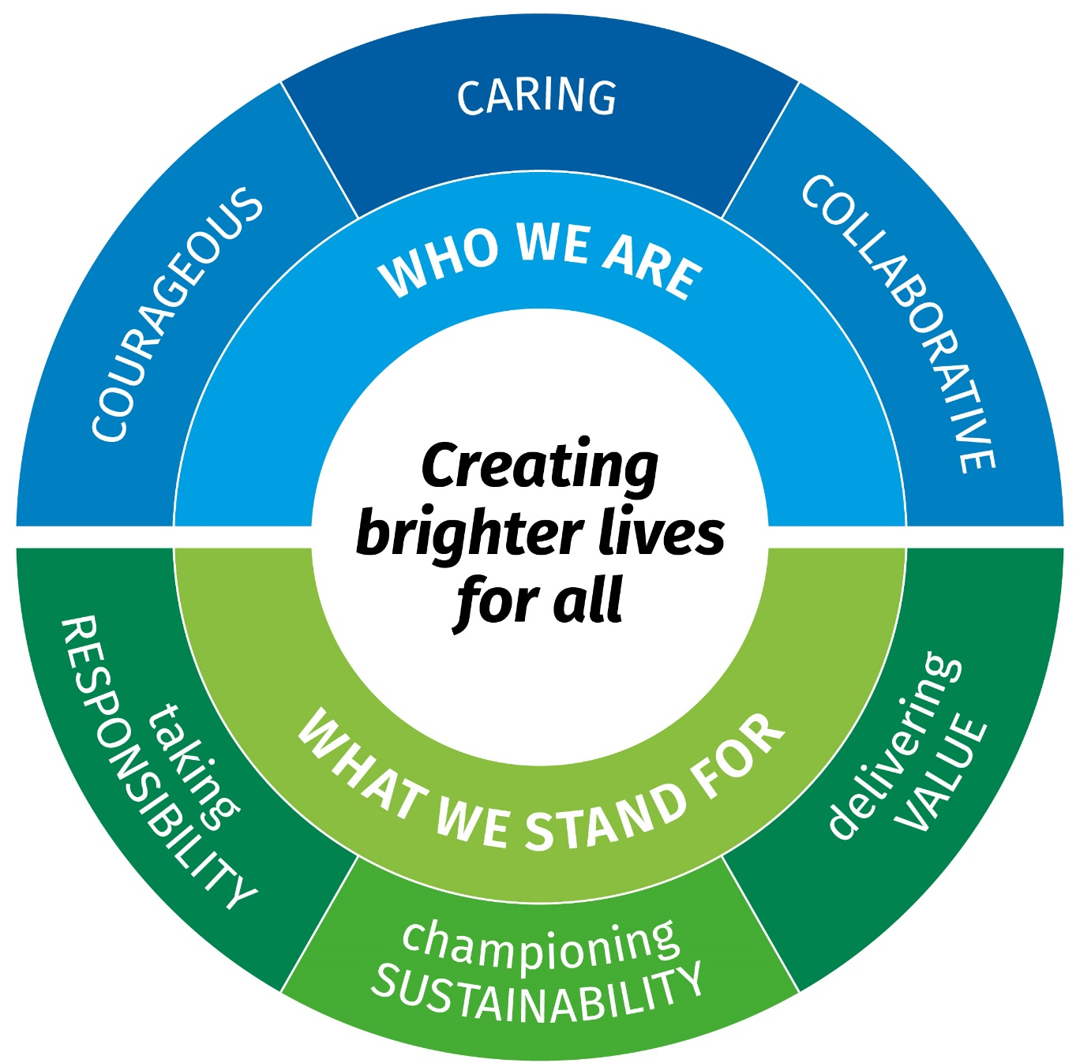
Guiding our purpose-led, performance-driven culture
Our culture compass is a navigational tool that helps us steer DSM to where we aspire to be. It shows us the future we’re aiming for, while allowing each of us to find our own ways of being DSM.
The compass also reflects our strategy to be purpose-led and performance-driven. Our purpose of creating brighter lives for all sits at the heart of the compass – it inspires everything we do. And we deliver performance by being more of who we are, and by taking decisions every day that show what we stand for.
The six outer sections of the compass – our ways of being DSM – help us define the culture we want to build and guide our day-to-day interactions and decisions.

Slide 7

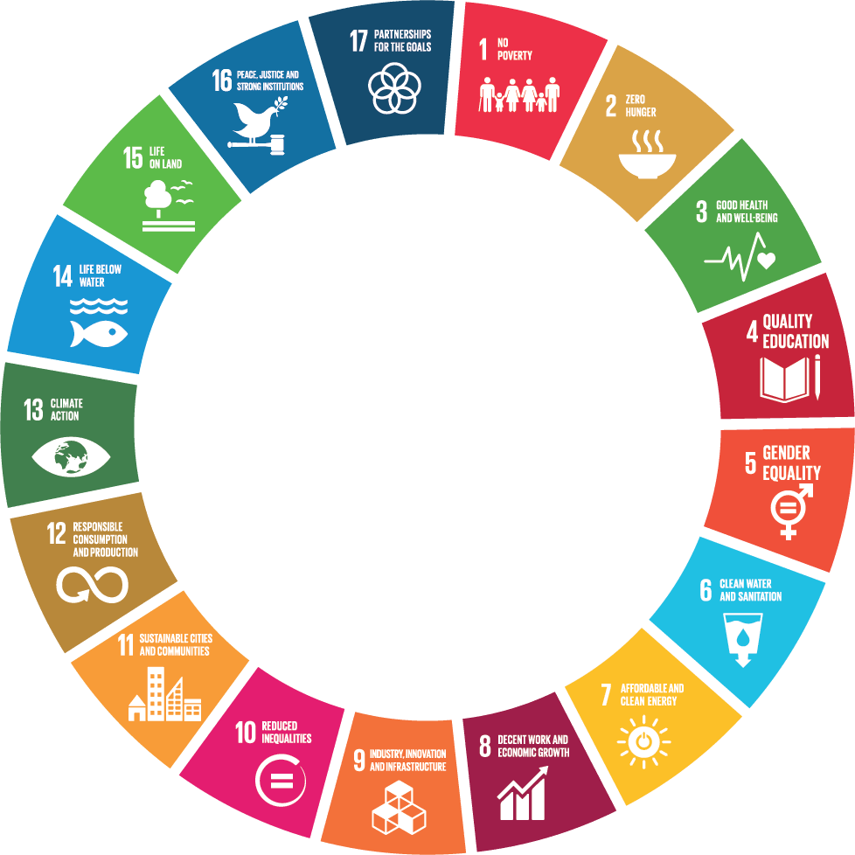
Our purpose is to create brighter lives for all
DSM solutions already reach
2.5 billion+ people worldwide

Slide 8
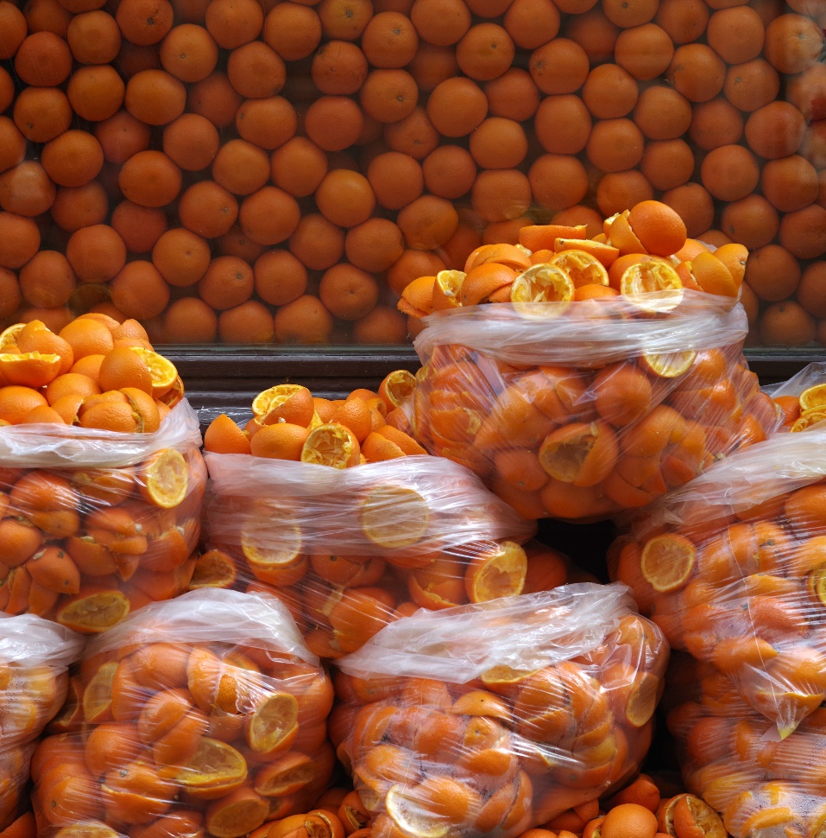

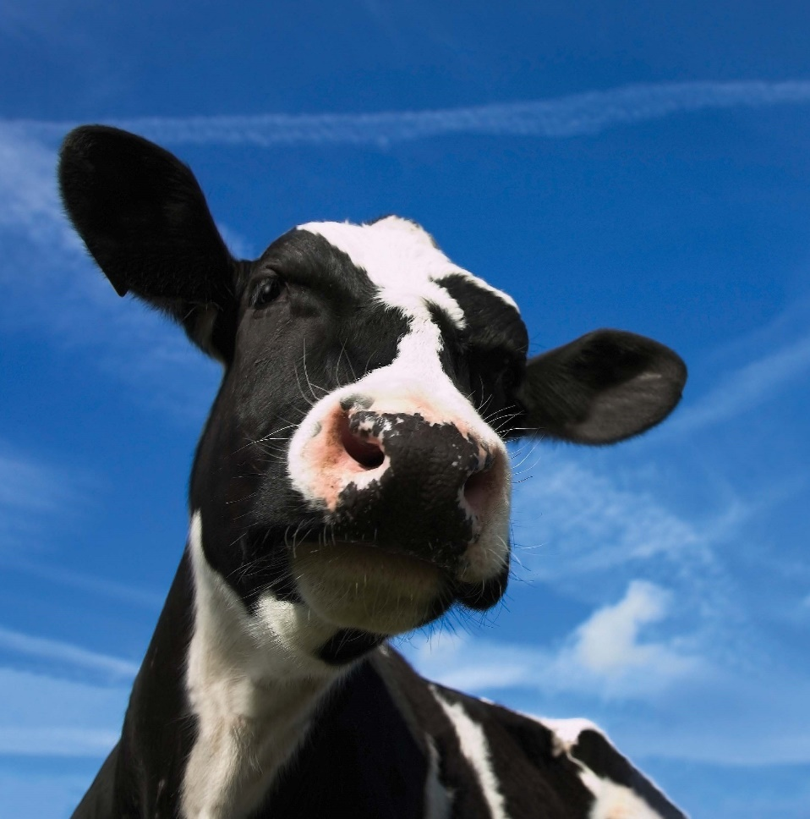

Accelerating our purpose-led, performance-driven journey
Global food systems
face multiple urgent
environmental and
societal challenges
DSM has the capability
and the responsibility
to make a
meaningful impact
DSM is fully focusing
its resources on
Health, Nutrition & Bioscience
Addressing these
challenges offers
exciting new market
opportunities for DSM

Slide 9


















Multiple interconnected challenges to global food systems
(Hidden) Hunger and malnutrition
NH₃
Emissions, incl. green house gasses (e.g. methane), nitrogen, ammonia and phosphorus
Inequality
Farmers unable to generate a fair and stable income in the value chain
Lacking basic needs such as food, healthcare and education
N₂O
Diet-related illnesses, non-communicable disease, obesity
CH₄
PO₄
Loss of biodiversity, deforestation, land and ocean ecosystem loss
Vitamin and mineral deficiencies
Immunity incl. anti-microbial resistance
Food loss & waste
Health for People
Health for Planet
Healthy Livelihoods

Slide 10

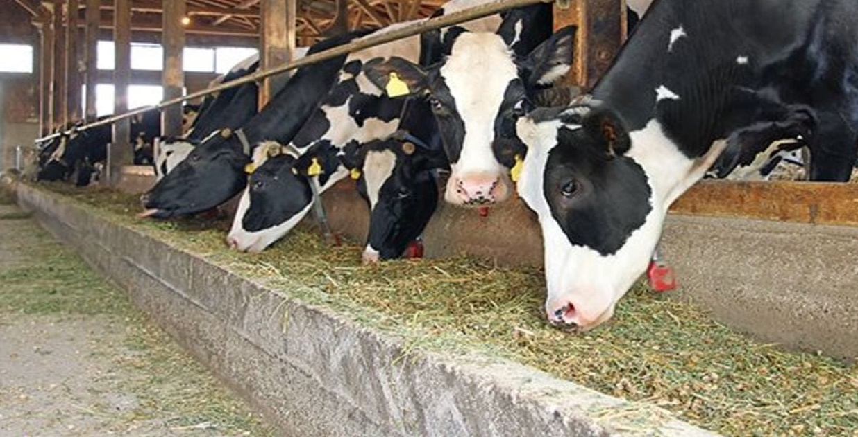
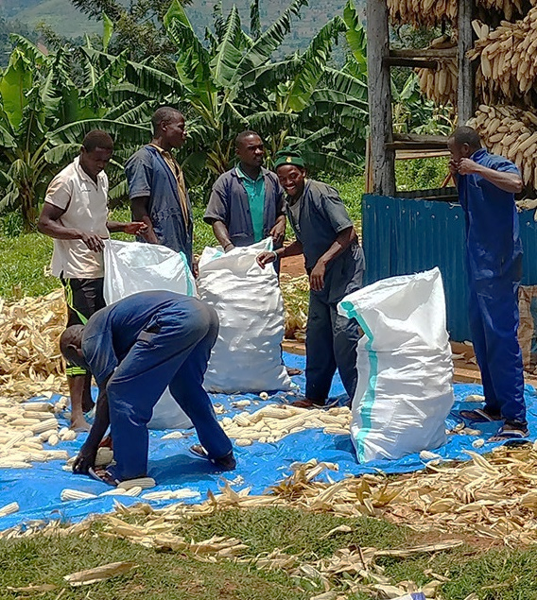


Caring for the world through our food system commitments
Closing the micronutrient gap for 800 MILLION PEOPLE by 2030
DOUBLE DIGITS on-farm livestock emissions reduction by 2030
Supporting the immunity of
500 MILLION PEOPLE by 2030
Reaching 150 MILLION PEOPLE with solutions for plant-based foods by 2030
Supporting the livelihoods of 500,000
SMALLHOLDER FARMERS by 2030
Health for People
Health for Planet
Healthy Livelihoods

Slide 11



Three Business Groups with clear end-market orientation
Animal Nutrition & Health
Radically more sustainable animal farming
Health, Nutrition & Care
Keeping the world’s growing population healthy
Food & Beverage
Healthy diets for all through nutritious, delicious and sustainable solutions
€3.4bn*
€2.5bn*
€1.3bn*
11
* Based on 2021 Net Sales

Slide 12
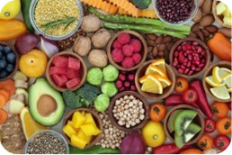







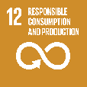

Increased general awareness of the critical role of nutrition, supported by rapid developments in science & technology
Trends and challenges
Bioscience & technology advances
Consumer
Society
Environment
Biotechnology breakthroughs
Data &
Digital
Precision & Personalization
Market opportunity for solutions that
offer health through nutrition
Science & technology enabling
unprecedented precision

Slide 13

DSM is able to meaningful contribute to the critical transformation of global food systems by exclusively focusing on Health, Nutrition & Bioscience.

Slide 14







Animal Nutrition & Health (ANH)
Sales
€3.4bn*
Poultry
Swine
Ruminants
Aqua
46%
22%
23%
9%
Key trends …
… for which DSM is uniquely positioned
Recent acquisitions
Professionalization of farming and ensuring farmers can earn a living
‘We Make It Possible’ with our current comprehensive portfolio of market-leading probiotics, prebiotics, enzymes and eubiotics for animal gut health
World-leading science-based innovation program has developed global game-changers such as methane-inhibiting feed additive Bovaer® and algae-based fish oil alternative Veramaris®
Unique global premix network with strong representation in every region of the world
Leading advances in precision farming analytical/diagnostic services such as Sustell™, Verax and Erber Diagnostics (Romer Labs®)
Helping tackle antimicrobial resistance
Reducing reliance on marine resources
Making efficient use of natural resources
Reducing emissions
from livestock
Improving lifetime performance of
farm animals
Improving quality while reducing food loss & waste
CH₄
Co₂
N₂O
* Based on 2021 Net Sales

Slide 15

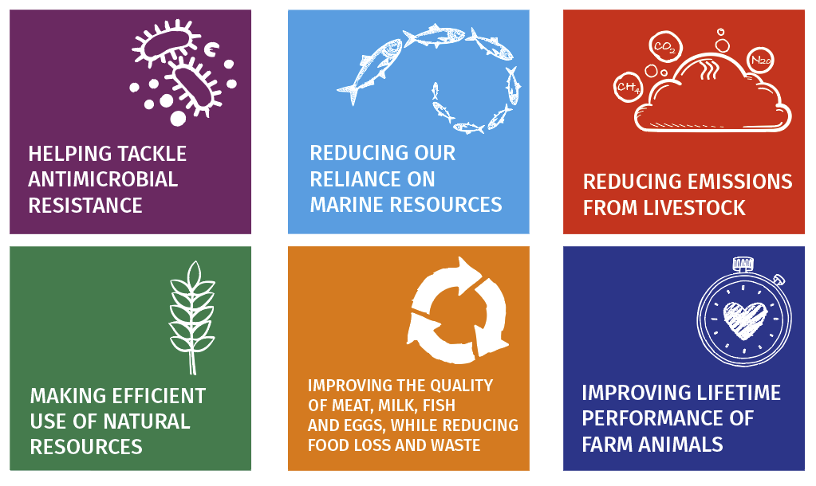
Our aim as DSM is to partner the industry to enable radically more sustainable animal production

Slide 16
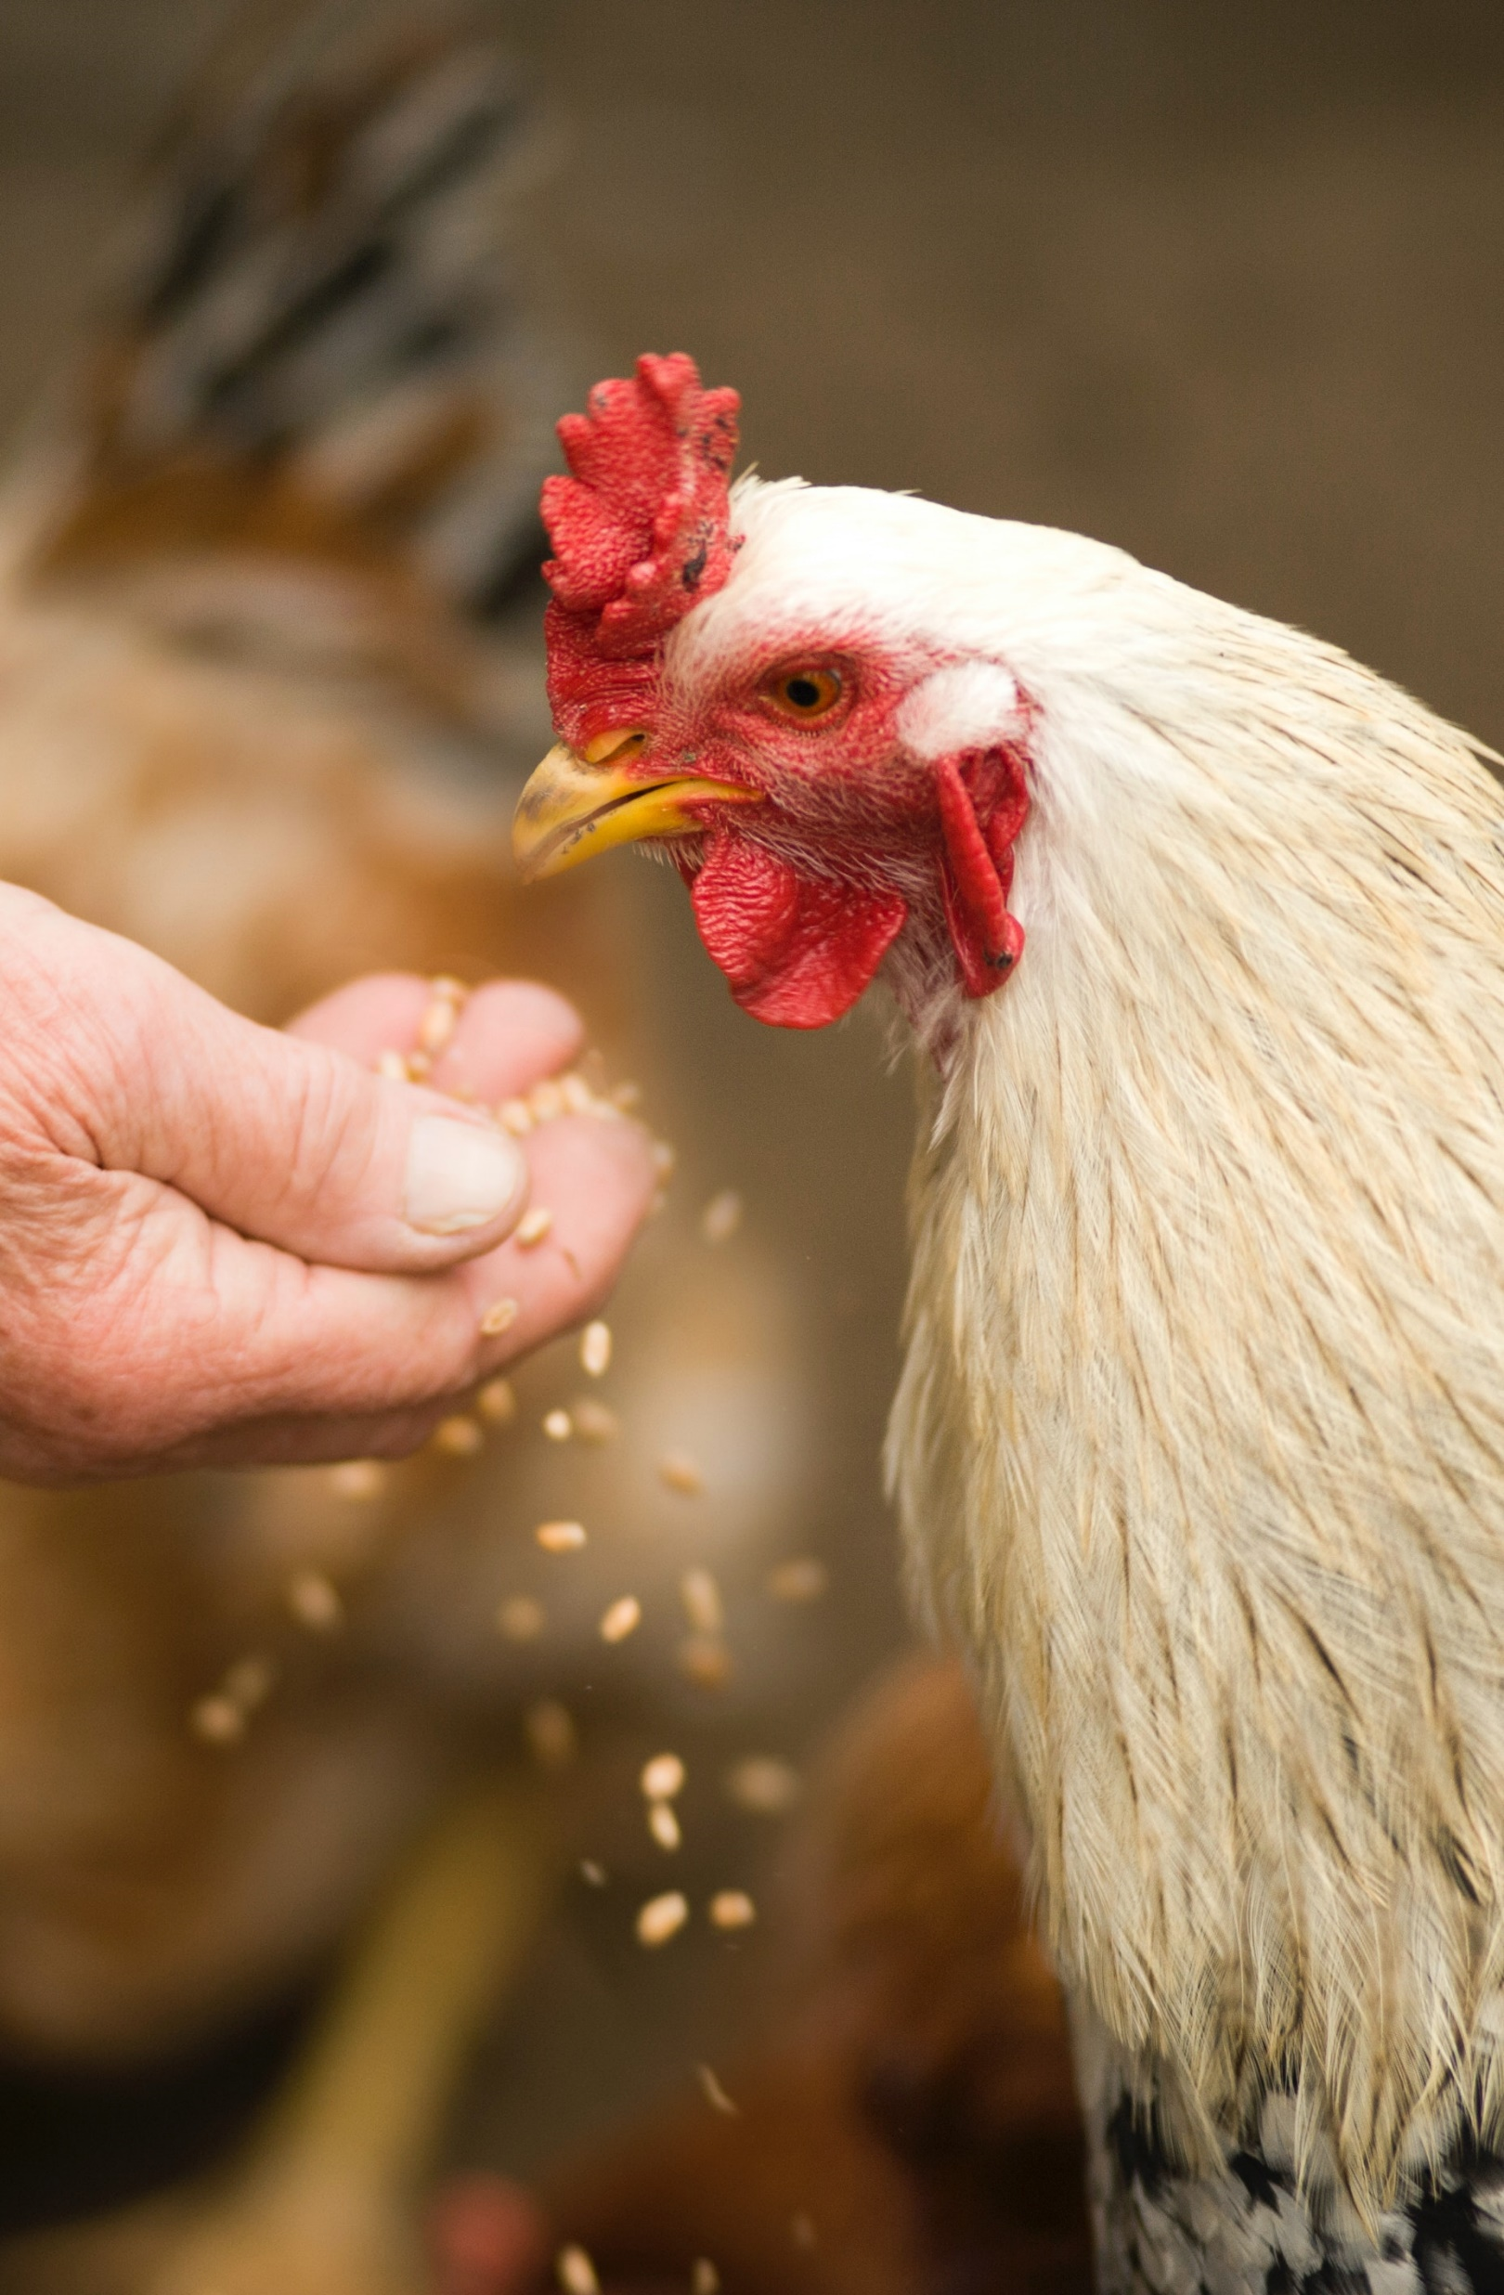

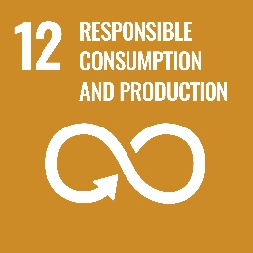

Making animal farming more sustainable
Animal farming is a crucial source of nutrition for much of the world but accounts for 14.5% of all human-derived greenhouse gas emissions and this figure is set to rise
Our customers need transformational ways to produce nutrition and health for all within planetary boundaries
A key area where we contribute is through scientific breakthroughs that reduce livestock emissions, with solutions including:
  Bovaer®: reducing methane emission in ruminants by inhibiting specific gut enzymes
  ProAct: reducing nitrogen emissions in poultry by improving protein digestibility
  VevoVitall®: safe alternative to antibiotics while reducing ammonia emissions in swine
  Sustell™: Advanced digital service enabling farmers to measure their environmental footprint and identify opportunities for improvement

Slide 17




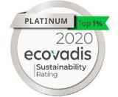



Taking full responsibility for our own footprint and people
ESG targets (set in 2019) accelerated in 2021 and again in 2022
GHG emissions reduction 50% by 2030
Energy efficiency >1% avg. p/yr. till 2030
Purchased renewable electricity 75% by 2030
Employee engagement
>76% by
2022
Safety Frequency Recordable Incidents
<0.20 by 2027
Female executives 30% by 2025
Validated science-based target on Green House Gases emissions reduction (scope 1&2) changed to 50% vs. 2016 baseline (was 30%)
Targeting NetZero GHG emissions across our operations and value chains by 2050
Raised internal carbon price from €50 to €100 per mt of CO2 to further guide investments and operational decisions
Water reduction target set with 10% efficiency improvement on water-intake at sites in areas of water stress by 2030
DSM top ranked in leading ESG-ratings
A for Climate A- for Water
Sector Leader
Top ranking

Slide 18
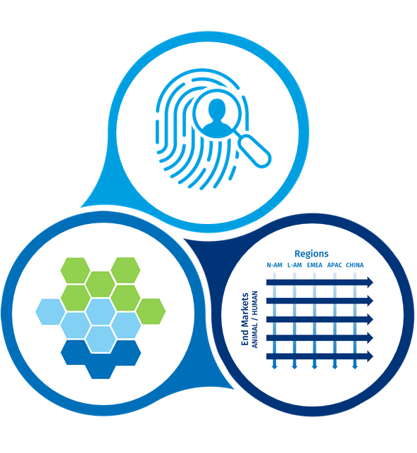
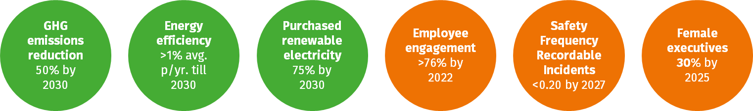
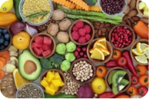









Building a company that delivers long-term profitable growth
Global food systems face huge environmental and societal challenges and offer opportunities
DSM is uniquely positioned and has the capabilities
to address these opportunities
This creates purpose-led positive impact for people and planet
Building a company that delivers long-term, performance-driven profitable growth
Responsibility for our own footprint and people
Caring for the world with measurable food systems commitments
Rich innovation pipeline
Ambitious mid-term profit targets
Mid-single-digit %
organic sales growth
Consumer
Society
Environment
Adj. EBITDA margins >20%
Health for
People
Health for
Planet
Healthy
Livelihoods
Biotechnology
breakthroughs
Data &
Digital
Precision & Personalization
High-single-digit %
annual adj. EBITDA growth
Great People, unique Culture

Slide 19

We’re helping the industry meet this complex challenge, by offering our customers a true end-to-end portfolio

Slide 20






For healthy development
For advanced solutions
For targeted insights

Slide 21
Vitamins for animal performance
Vitamins contribute to both well-being and performance. With more than 70 years’ experience, we offer the world’s largest portfolio of trusted animal nutrition products.
Essential nutrition is fundamental to the production of healthy, sustainable animal protein.
Our Essential Products provide vital nutrients for the healthy growth and development of farm animals
— delivered to the customer in the most flexible, tailored way.
Premixes customized for your needs
Our premixes are customized blends of functional ingredients – vitamins, minerals, amino acids, nucleotides, nutraceuticals, prebiotics, fibers, herbs and more – delivered to you in a single, homogenous compound.
Carotenoids for product quality
Carotenoids play a key role in animal health and reproduction, while helping ensure product quality, meet consumer expectations, and prevent food waste.

Slide 22
Enzymes unlock nutrient potential
Our feed enzyme portfolio enhances the wellbeing and performance of livestock by unlocking nutrient potential in feed and lower feed costs.
Mycotoxin deactivation
We harness the power of science to support all aspects of animal health and performance. With our BIOMIN portfolio,
we are world leaders in advanced mycotoxin risk management techniques, including mycotoxin detection and mycotoxin deactivation.
Our Performance Solutions + BIOMIN® are designed to improve the sustainability and profitability of
animal farming
Our broad portfolio delivers the level of functional nutrition needed for the industry to meet the challenges of sustainability, animal welfare and feed quality
We are proud to welcome BIOMIN® —
a global leader in nutritional science and mycotoxin deactivation — to the
DSM family
Eubiotics in balance
Our range of eubiotics delivers an optimal balance of microflora to promote efficient gut performance, ensuring
that animals get the most from their feed.
Special nutrients
Our unique Hy-D to achieve optimal Vitamin D status for improved immunity, skeletal health and animal performance

Slide 23
Improve animal sustainability
Our global sustainability service, Sustell™, allows farmers to measure their actual environmental footprint and identify the best possibilities to improve, and providing advice and practical solutions for implementation.
Greater precision in animal farming is
key to a more sustainable and profitable future.
Our Precision Services use the latest data analytics and diagnostics to improve animal health, lifetime performance, resource use and environmental footprint — while mitigating risks and unlocking more value.
Improve animal health
Our animal health management service, Verax™, uses the power of diagnostics to enable farmers to adjust feeding regimes and optimize their animals’ health, productivity, and welfare by providing evidence-based recommendations for better nutrition and performance.

Slide 24
Performance Solutions toolkit for addressing challenges across all major species
Feed Optimization
Gut Health
Mycotoxin Risk Management
Special Nutrients
Broadest portfolio of enzymes and services to enable precision nutrition for feed efficiency and reduced environmental impact
RONOZYME® HiPhos
RONOZYME® Multigrain, WX, VP, HiStarch, Rumistar
RONOZYME® ProAct
Comprehensive range of eubiotics to ensure gut health, functionality and performance
Organic acids
Probiotics
Prebiotics
Phytogenics or essential oils
Gut health enzymes
Advanced mycotoxin risk management, including mycotoxin detection services and mycotoxin deactivation solutions
Mycofix® Plus
Mycofix® Select
Unique solution to achieve optimal Vitamin D status for improved immunity, skeletal health and animal performance
HyD®

Slide 25
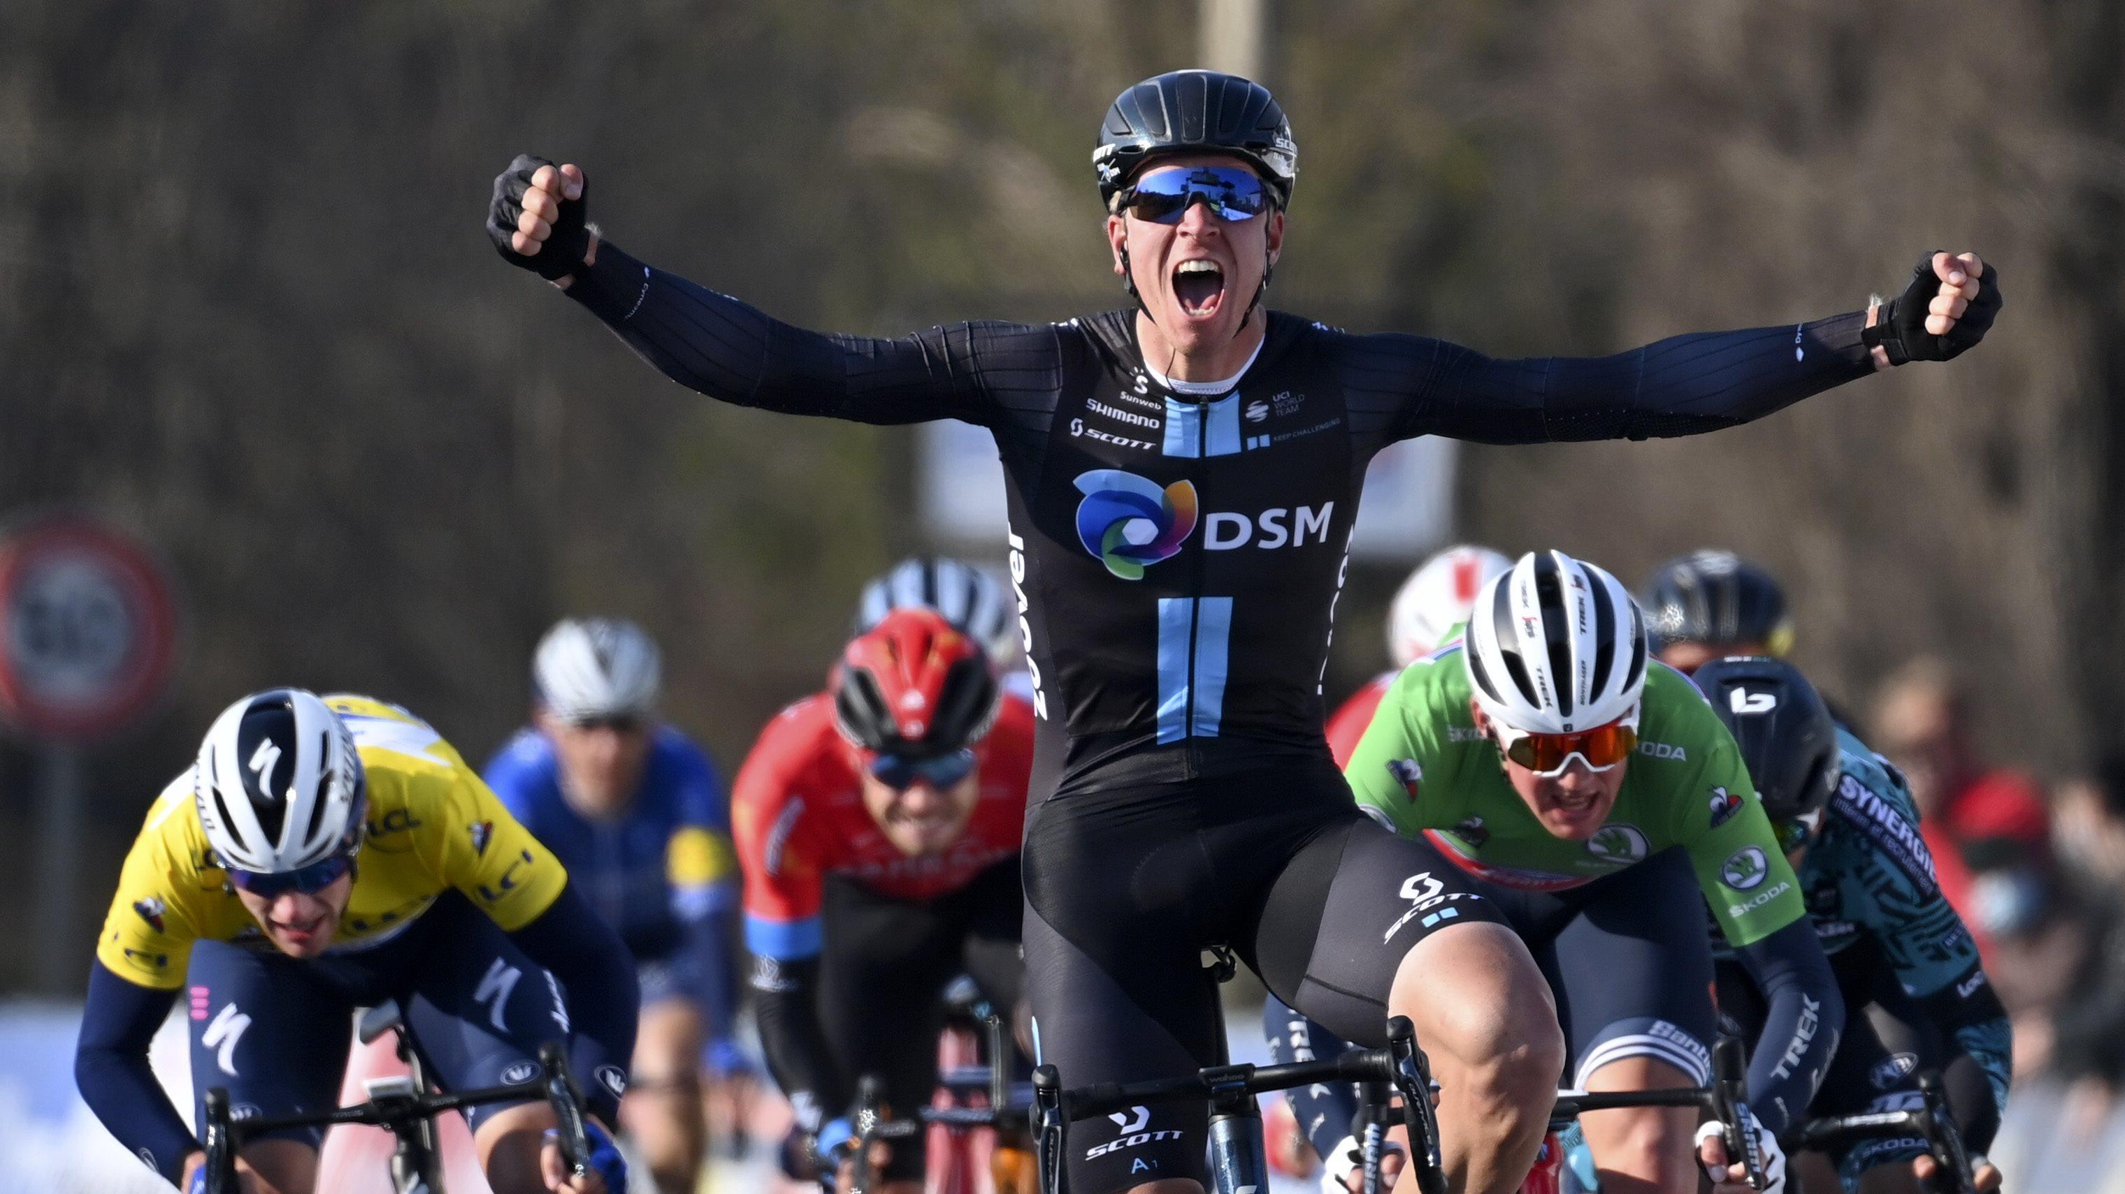
Purpose-driven partnership with Team DSM
Notes:
One of the top ranked and most exciting young teams in professional road cycling is known as Team DSM from 1st January 2021.
Through this partnership DSM hopes to galvanize wider public action around the importance of the health of people and of the planet, in line with the company’s purpose-led, performance-driven strategy.
Building on an existing innovation partnership over the past half-decade, Team DSM will continue to ‘Keep Challenging’ by taking their nutrition, equipment and personal care to a whole new level. DSM will support the Men’s, Women’s and Development programs equally to become the best that they can be – inside and out.
DSM and Team DSM will also undertake several joint activities, including amongst others:
Develop and produce the team’s very own race apparel, in cooperation with technology partner Bioracer, to set new standards in protective race wear that utilizes peak performance materials.
Develop personalized, sustainable sports nutrition for each rider using the latest scientific knowledge, data insights and ingredients, in cooperation with sports nutrition partner Sanas.
Provide additional investment to increase the intensity of fully independent anti-doping testing in the team, executed by “Dopingautoriteit” (Dutch NADO), according to WADA standards.

