Slide 1

We Make It Possible!
Solution on market challenges
Zsolt Csavajda – Gábor Jakab – RuszlánWladimir
DSM Nutritional Products Hungary

Slide 2
Irregular class of History

Slide 3
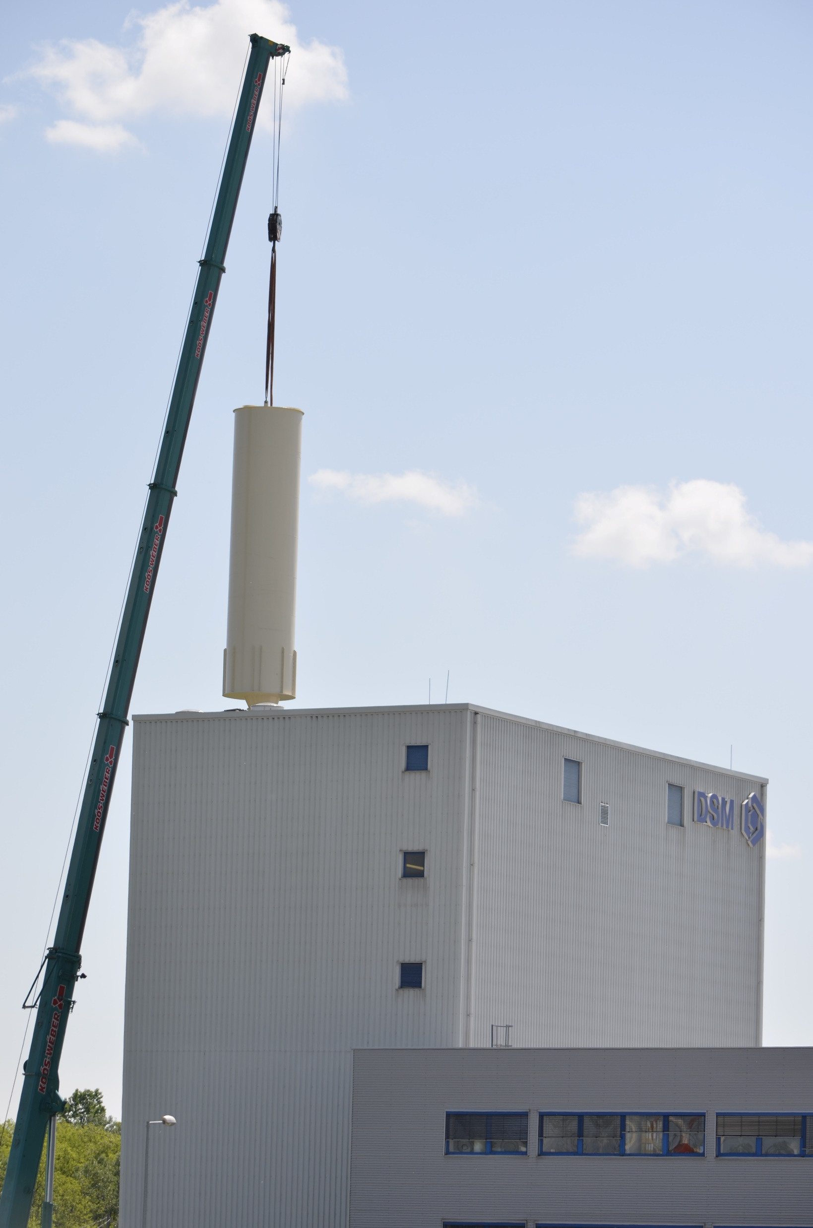
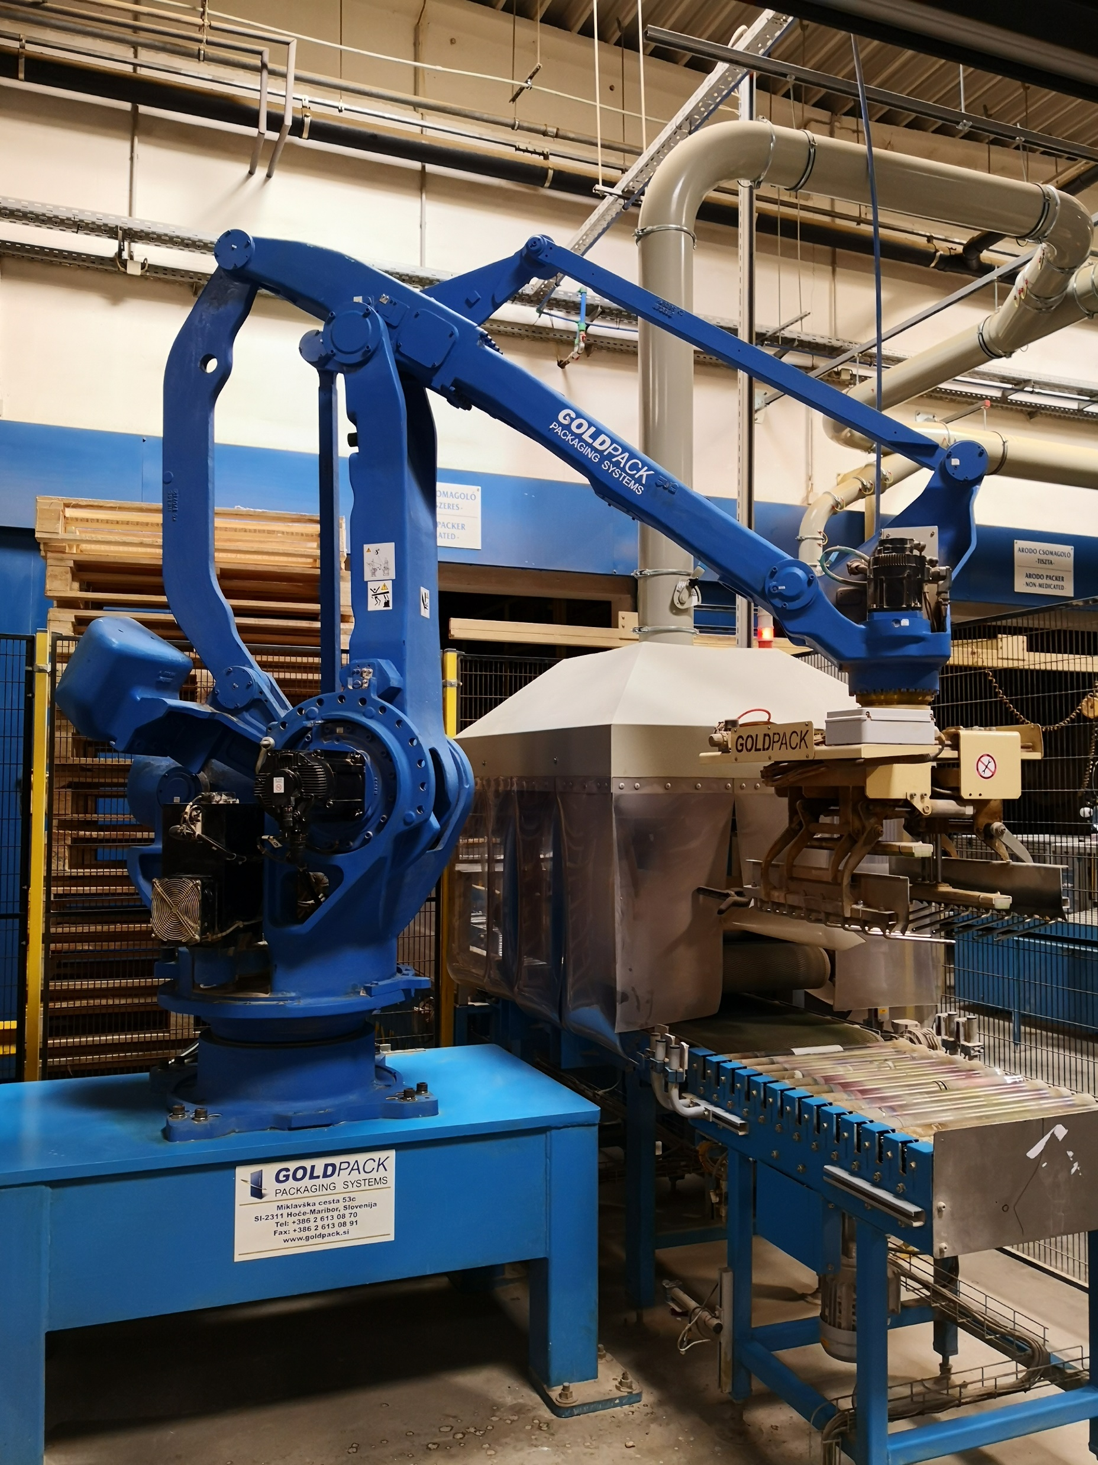




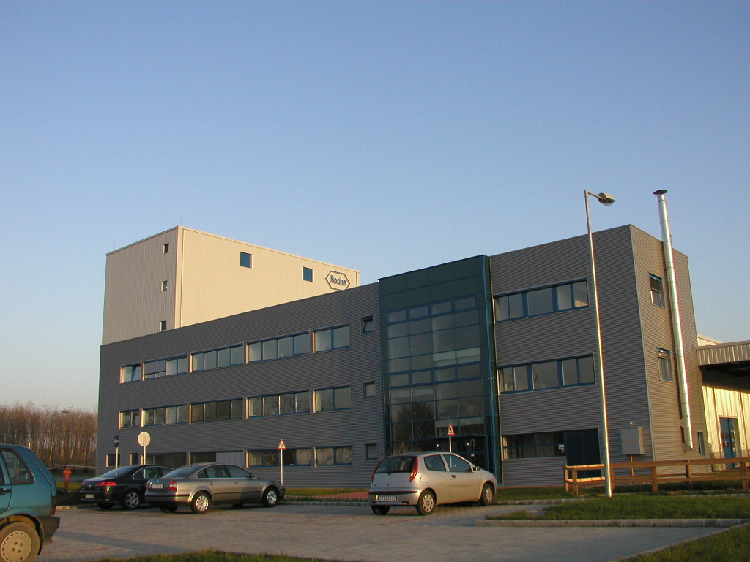
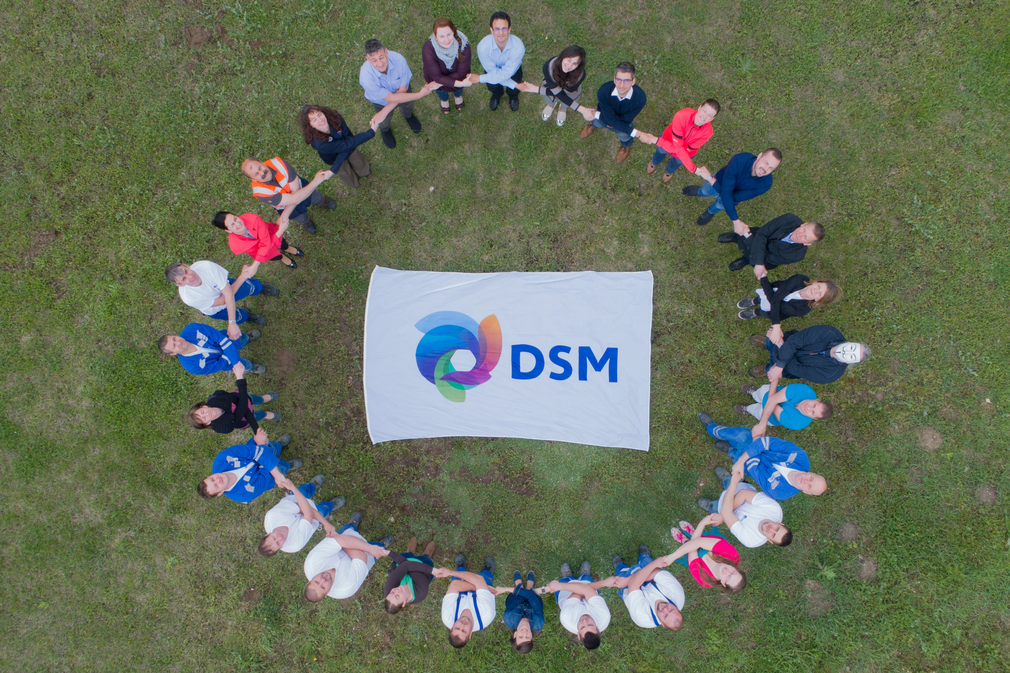
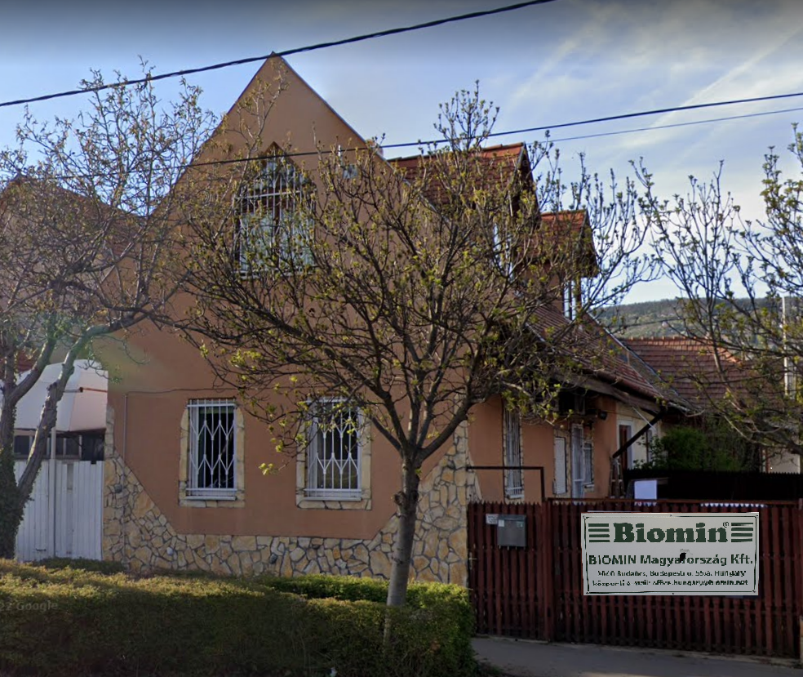
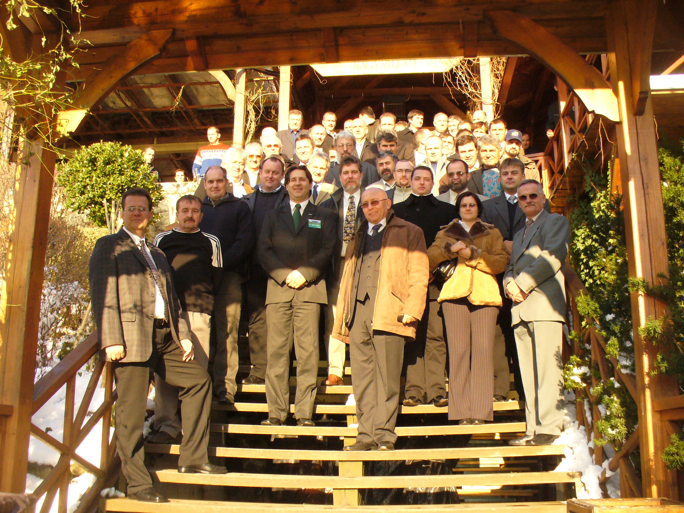


20 years…
Premix
plant
DSM
Czeh & slovak
market
Capacity
improvement
20,000 to
Robot
palletizer
STAR
project
Independent
representation
Office in
Budaörs
Mycofix
EU registration
Foundation
2002
2004
2009
2012
2015
2018
2021
2022

Slide 4
20 years in numbers

Slide 5
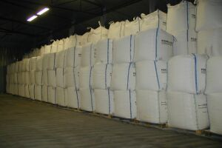


260.467 to premix
  46.644 to in bigbag
Equal to 1343 m of Chinese Great Wall

Slide 6
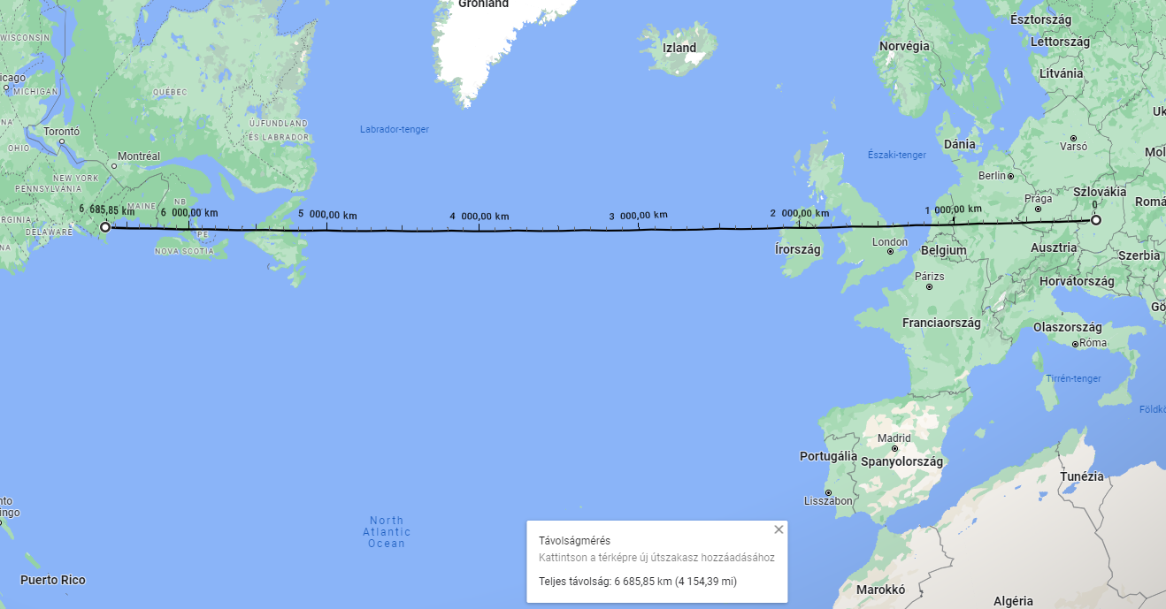
213.823 to in regular bags...
From the Újhartyán gate to Boston

Slide 7








We provided premixes to 48,41 mio to
of final feed as raw material
Equal to nearly
2 Velencei lake
Premixeinkkel
48,41 millió t keveréktakarmánhoz adtunk alapanyagot.
Ez közel 2 Velencei tó

Slide 8
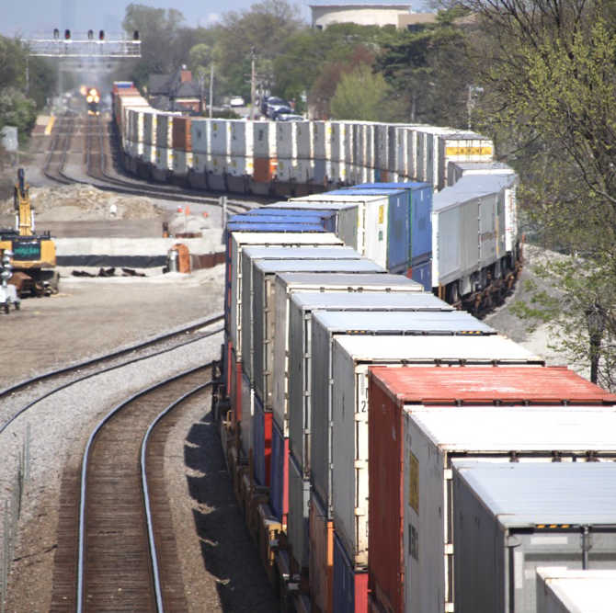
We have sold 64.532 to of amino acids as straights and captive
which equals to
33,8 km long train

Slide 9
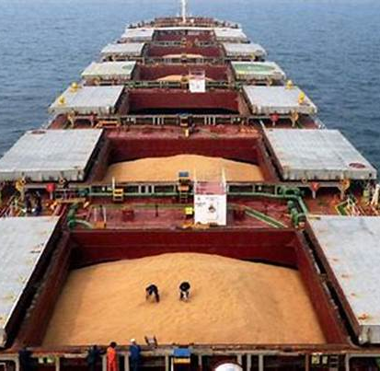
We have replaced 79.979 to of soys
by using Ronozyme ProAct

Slide 10
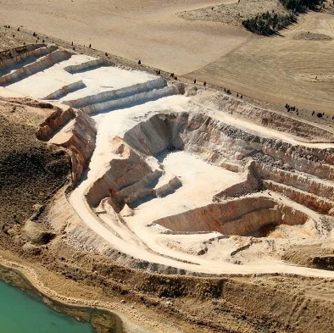
By applying our phytase enzyme
you had to use 107.442 to less MCP in your final feed

Slide 11
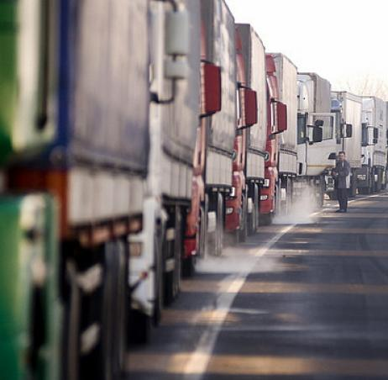
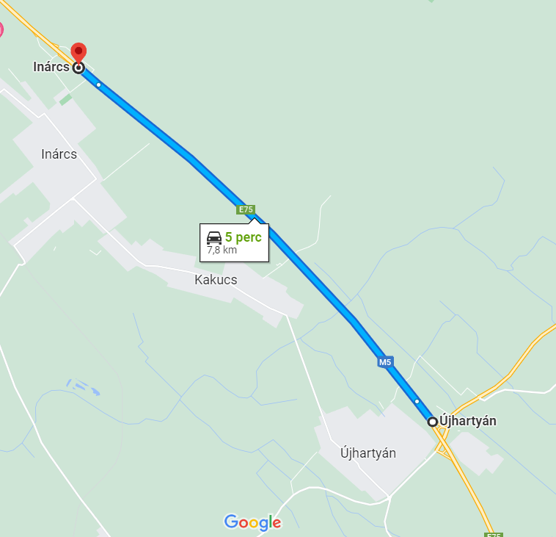
Sold Mycofix@
7,8 km line of trucks
Notes:
430 kamion

Slide 12

4,579 mio to toxin-reduced finished feed,
...equal to 3 Great Pyramids of Giza
Notes:
Gizai nagy piramis: 2 484 448
Hafré piramis 2 106 587
Menkauré piramis 233 432
Total 4 824 467

Slide 13
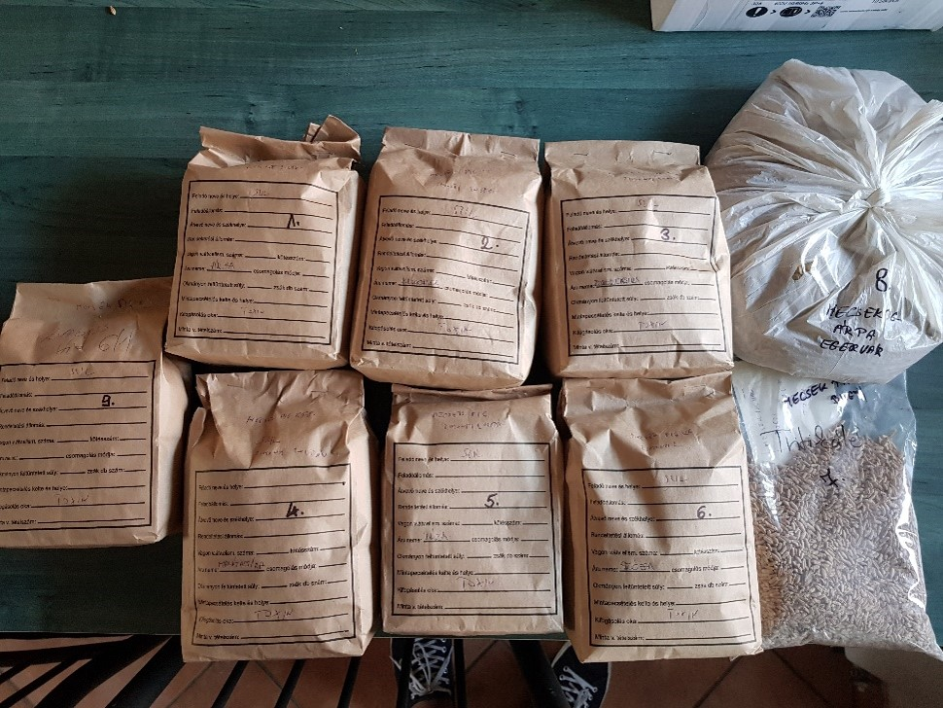
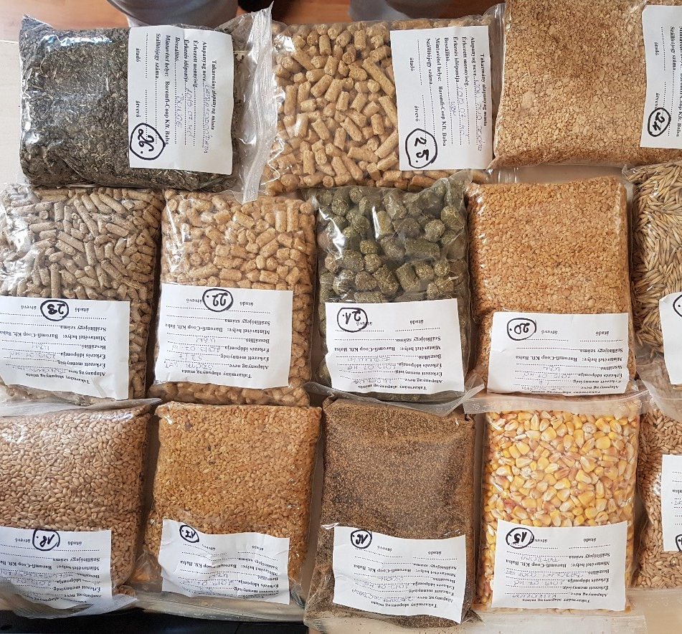
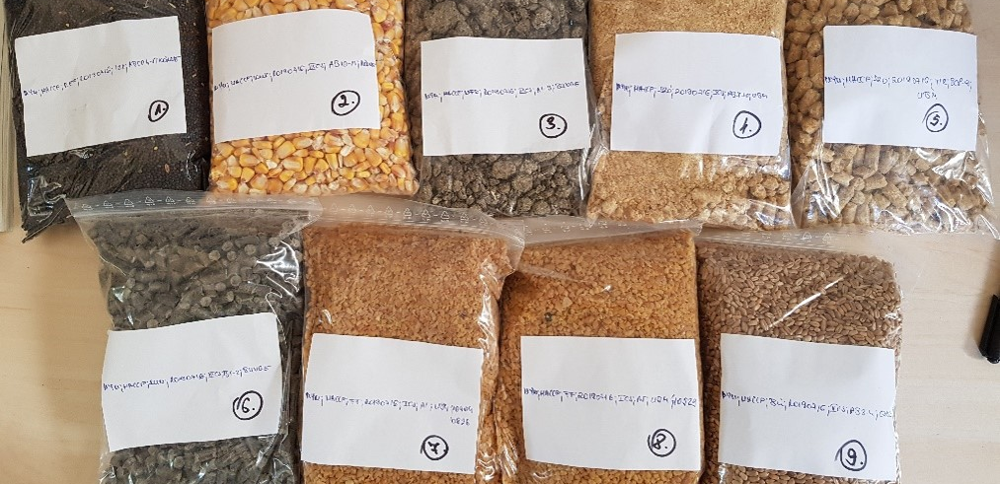
7657 samples was analysed at our lab in Tulln
2,2 years' work of one person

Slide 14



Present and future…
Reliability
Price & cost
Quality
Efficiency
Reputation
Science
Innovation
Service
Sustainability
Documents
Application Information

Slide 15







Slide 17
Raw material & additive market
ECONOMICAL & MARKET FOUNDATIONS – Decreasing demand, low prices (minimum)
Global meat consumption grows
Farmers, suppliers suffer of complex problems (COVID, ASF, ABF, costs, inventory, drought)
5-15% of demand decrease, saving behavior
High stocks, low prices, increasing production cost
Producers in difficult situation – consolidation (supply-demand)
All above would drive prices higher
TECHNICAL FOUNDATIONS – Improve efficiency, new type of consumer demands and trends
Precision nutrition, more accurate feeding of animal needs
Rules, regulations (antibiotic usage, ZnO)
Sustainability, reducing emission, CO2 footprint calculation
Animal welfare, healthy food

Slide 18
Vitamins
  Vitamins are irreplaceable nutrient, their cost is a fraction of feed however any deviation may jeopardize animal health and productivity without any significant savings in cost
  Do not take risk for few cent! Stick to your original formula and nutrient values!
Raw material volatility
☹
Vitamin Volatility
☹ Vitamin Volatility
*Approx cost of average vitamin levels in broiler feed in Latam, March 2022; most of feed cost and volatility originated by raw materials
Notes:
-Vitamin volatility: severe vitamin A and E shortage (and some other vitamins) due to Basf Quality issues and Chinese Government restrictions impacting vitamin production due to environmental issues originated an unprecedented volatitliy in vitamin availability with peak prices in 2018 (highest vitamin prices in decades).
*Approx cost of average vitamin levels (without HyD, vit C) in broiler feed in Latam (Brazil, Mexico, Colombia, Peru), March 2022

Slide 19


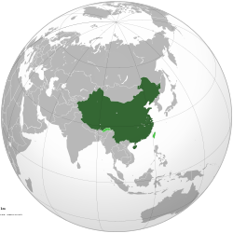
Vitamins
    Energy crisis – BASF?
    Production cost
    Labor
    Temporary production gaps(A,E)
    Long term reliability
    Efficiency
    Quality
    Local source
    Environmental issues
    Governmental interventions, COVID etc.
    Freight
    Exchange rate
    Energy position
    Labor
    Volume
    Cost structure
Karotinoids:
drought / quality of corn: egg yolk and skin pigmentation (Carophyll Yellow)
Notes:
-Vitamin volatility: severe vitamin A and E shortage (and some other vitamins) due to Basf Quality issues and Chinese Government restrictions impacting vitamin production due to environmental issues originated an unprecedented volatitliy in vitamin availability with peak prices in 2018 (highest vitamin prices in decades).
*Approx cost of average vitamin levels (without HyD, vit C) in broiler feed in Latam (Brazil, Mexico, Colombia, Peru), March 2022

Slide 20
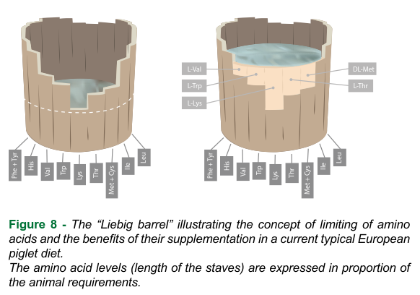
Amino acids
Global demand grows, industry consolidation, supply chain security (lys-thr)
New amino acids become regular in feed formulas: Arginine, Iso-Leucine,
Histidine – already commercially available
DL Methionine, Lysine és Threonine: global production overcapacity with growing demand
Tryptophane és Valine capacities are sufficient, further strong growth
Amino Acids give among the best opportunities to optimize diets in respect to upcoming legislation for CFP and N-polution
If carbon pricing will come in force, conscious decision about origin of products can help to save a lot of CO2 purchase, so save a lot of money!

Slide 21
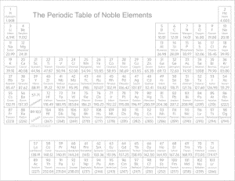
Minerals and other raw materials
The production cost of most materials increases:
  Phosphoric acid (MCP, DCP); Manganese ore (MnO, MnSO4)
  Energy (general, mostly MgO, FeSO4, SoBi, SiO2)
  copper and zinc prices fall: -20% vs Q2.
Demand decreased similarly to other feed supplements, except KCl – (RU, BY) and choline (EU origin)
USD vs. EUR exchange rate
Supply security has never been more important than now
The availability and price of raw materials affects the formulation (e.g. phosphorus/phytase)
Energy and freight costs remain high
Local sources (lime, salt, carrier) - carbon footprint?
"New parameters”:
  Focus on CO2 reduction

Slide 24
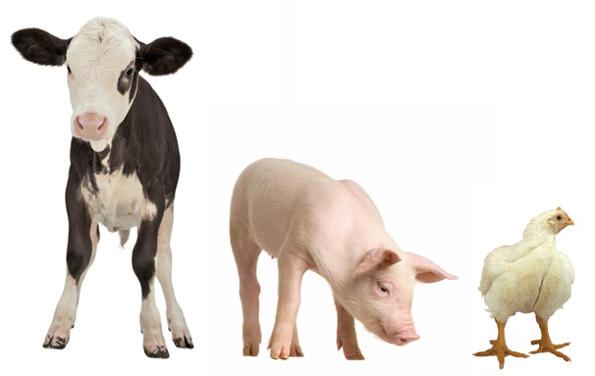
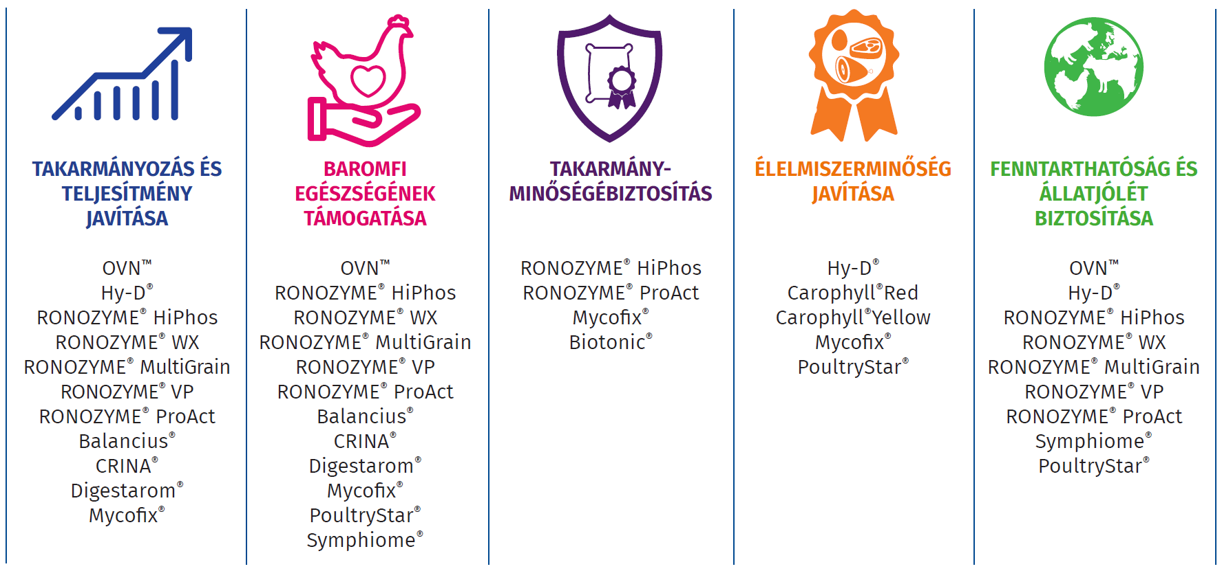




PERFORMANCE PORTFOLIO
AZ ÁLLATOK
EGÉSZSÉGÉNEK
TÁMOGATÁSA

Slide 25

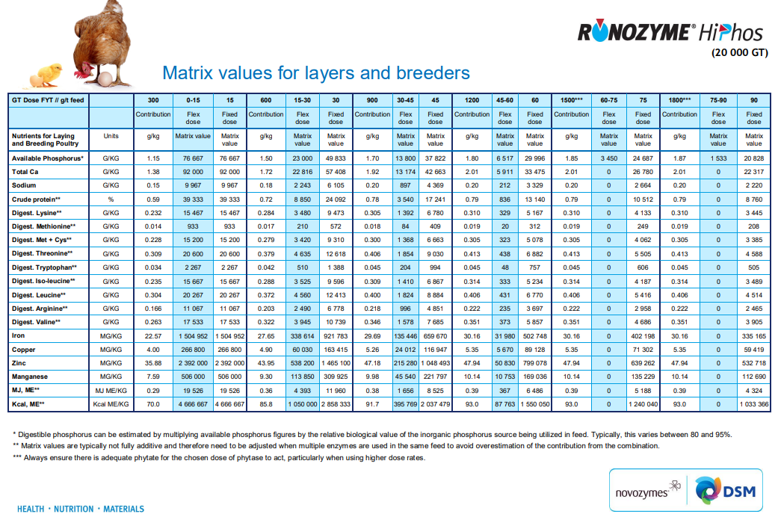
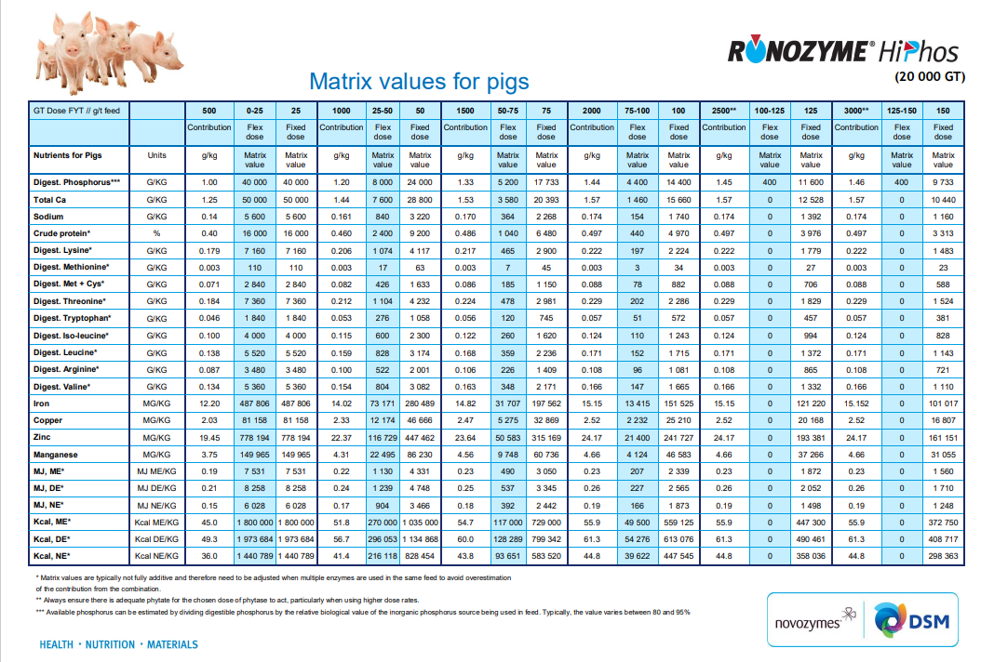
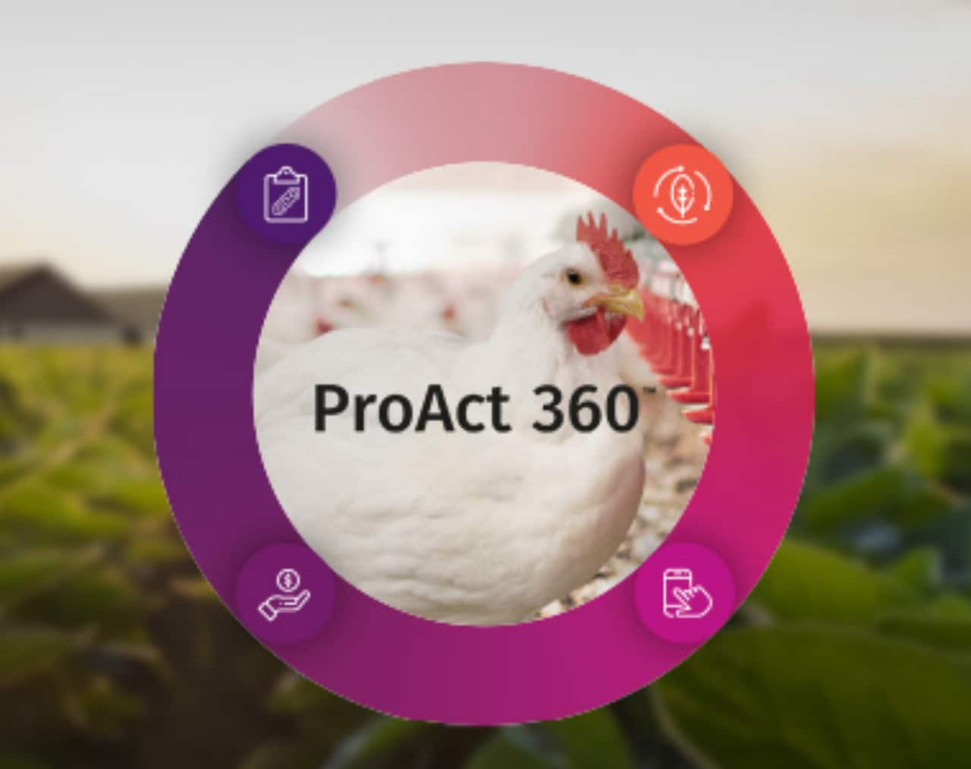
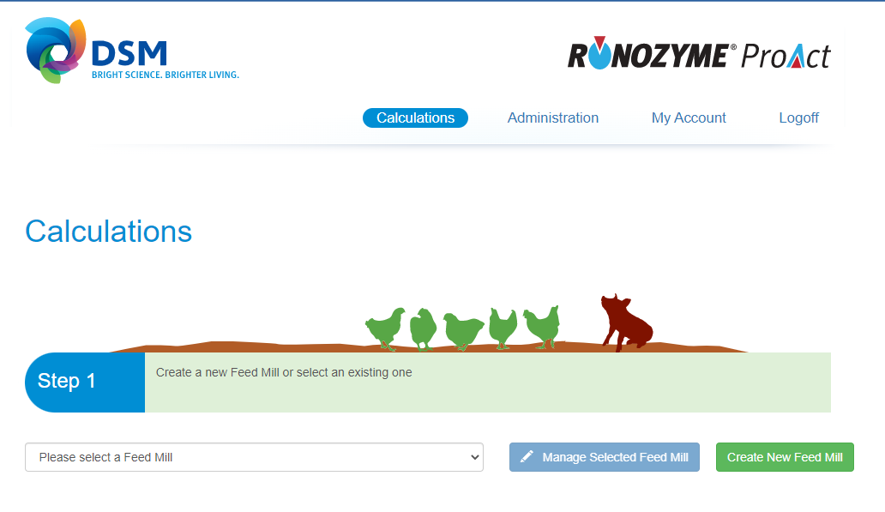
Matrix values are public data

Slide 26
PERFORMANCE PORTFOLIO
AZ ÁLLATOK
EGÉSZSÉGÉNEK
TÁMOGATÁSA

Slide 27
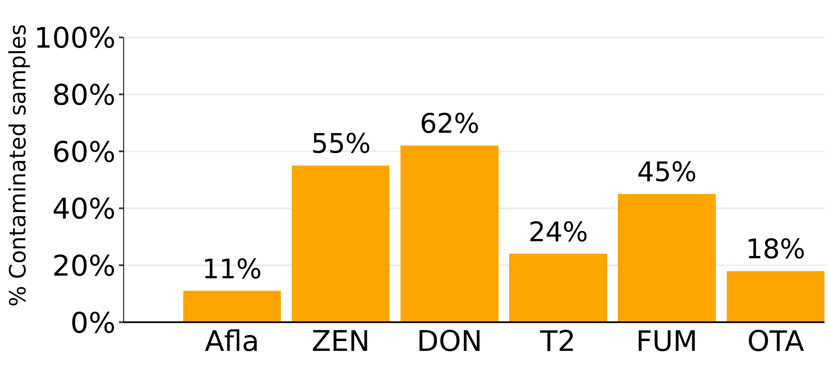
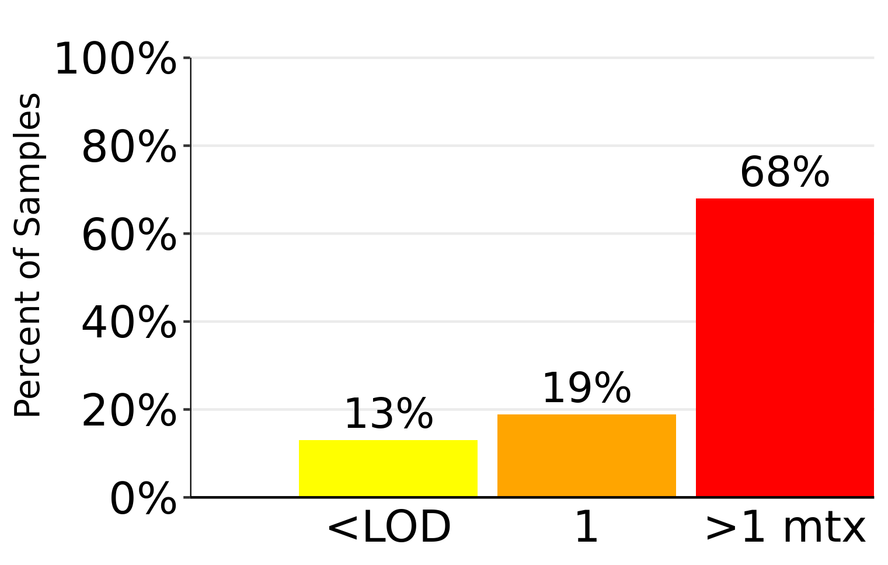
Mycotoxin levels in Central Europe, 2022
Parameter | Afla | ZEN | DON | T2 | FUM | OTA
Number of samples | 1172 | 2214 | 2309 | 1196 | 1149 | 1156
% Contaminated samples | 11% | 55% | 62% | 24% | 45% | 18%
% Above risk threshold | 6% | 20% | 48% | 4% | 10% | 2%
Average of positives (ppb) | 4 | 76 | 685 | 35 | 573 | 5
Median of positives (ppb) | 2 | 34 | 320 | 15 | 146 | 3
Maximum (ppb) | 123 | 1414 | 21200 | 437 | 11590 | 105

Slide 28
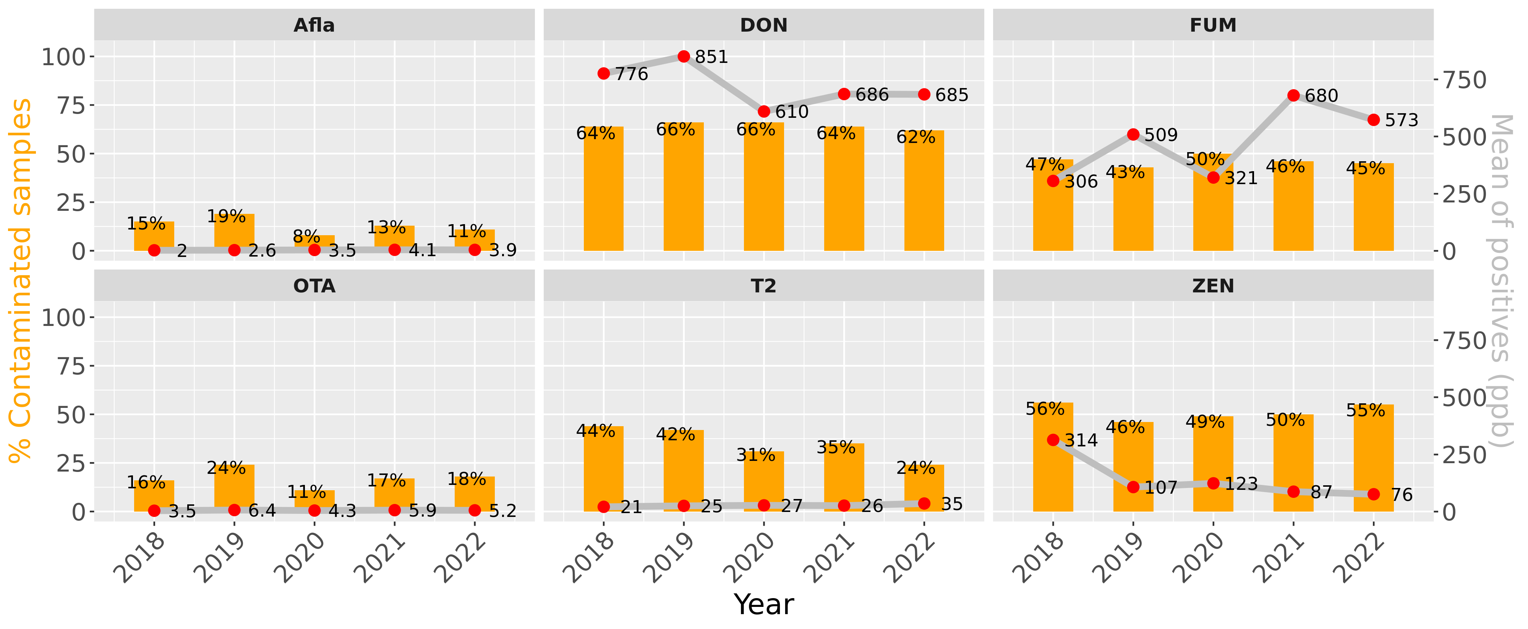
Mycotoxin trends from 2018 in Central Europe

Slide 29

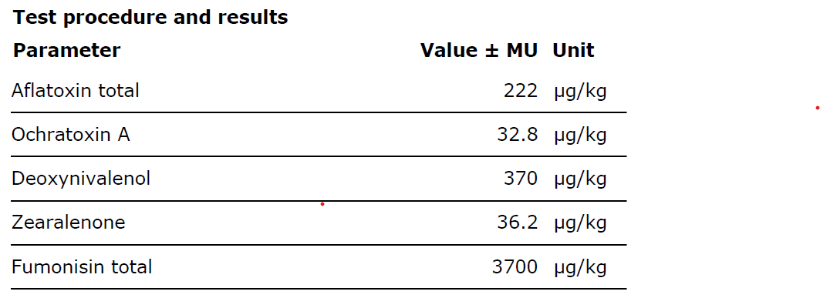
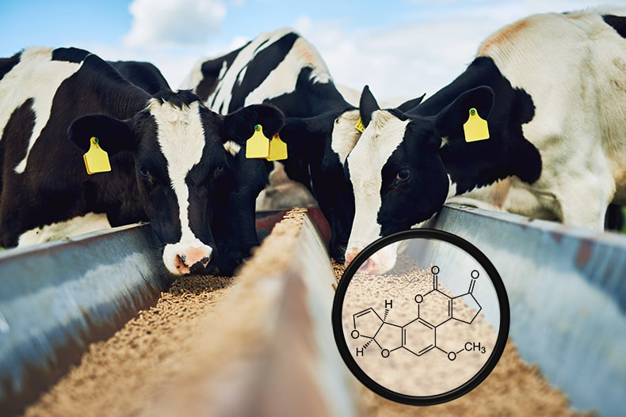
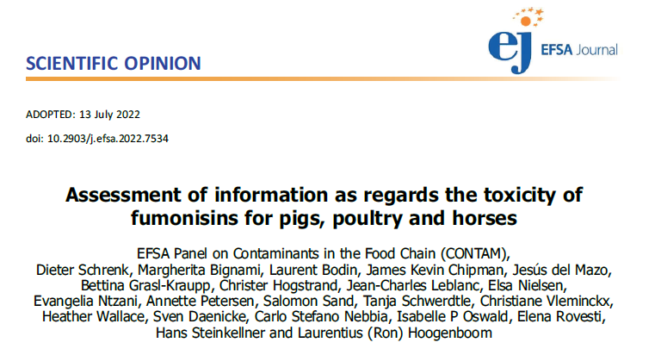
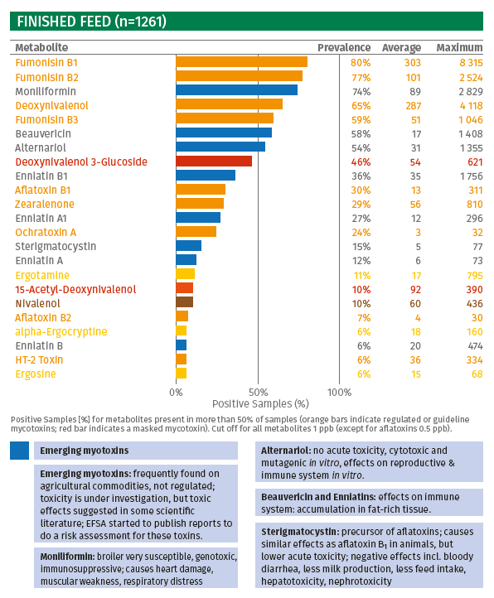

Mycotoxin news
Aflatoxin risk
(+ others)
A new scientific opinion of EFSA 2022: risk assessment of FUM in pigs, poultry
New insights on “emerging”and „masked” mycotoxins
!
Emerging mycotoxins: frequently found on agricultural commodities, not regulated; toxicity is under investigation, but toxic effects suggested in some scientific literature; EFSA started to publish reports to do a risk assessment for these toxins.

Slide 30
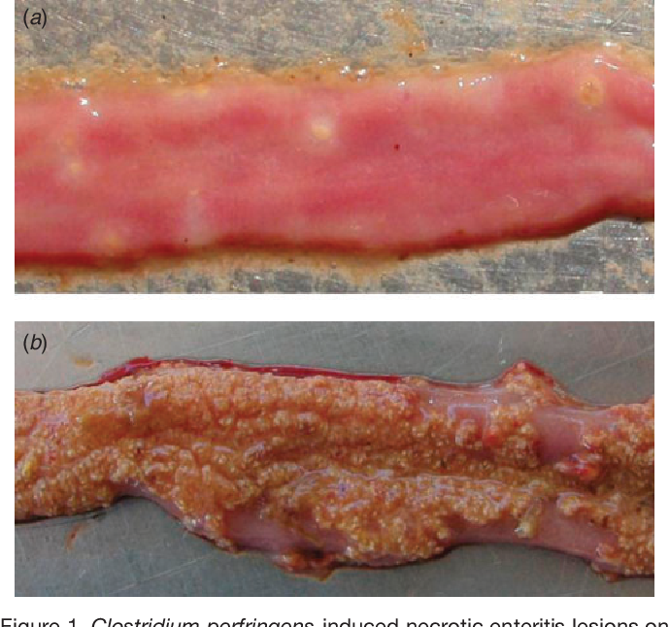
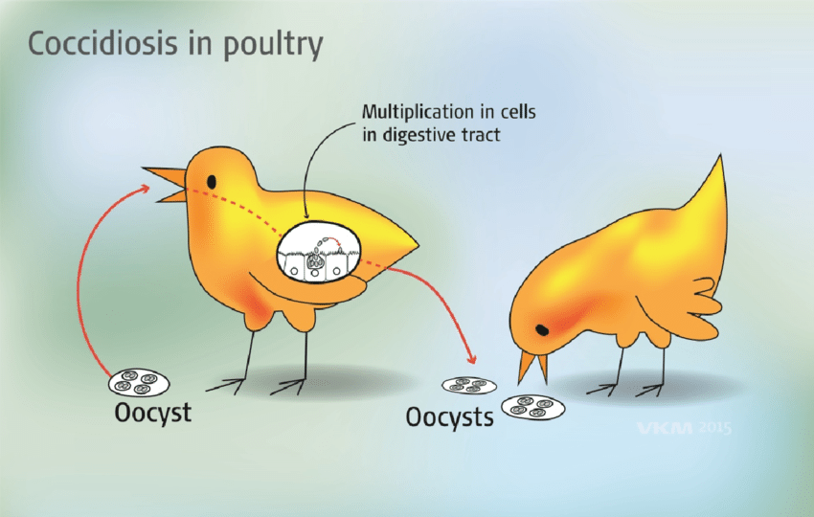
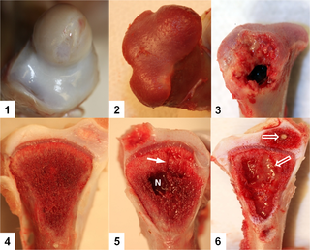
PERFORMANCE PORTFOLIO
AZ ÁLLATOK
EGÉSZSÉGÉNEK
TÁMOGATÁSA

Slide 31
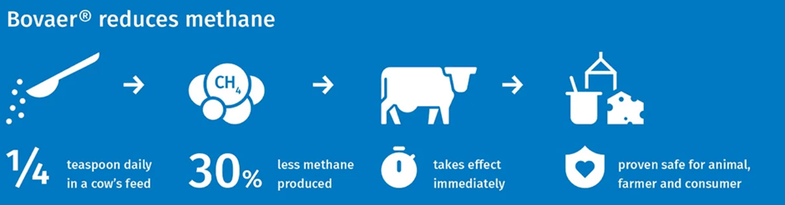
PERFORMANCE PORTFOLIO
AZ ÁLLATOK
EGÉSZSÉGÉNEK
TÁMOGATÁSA

Slide 34
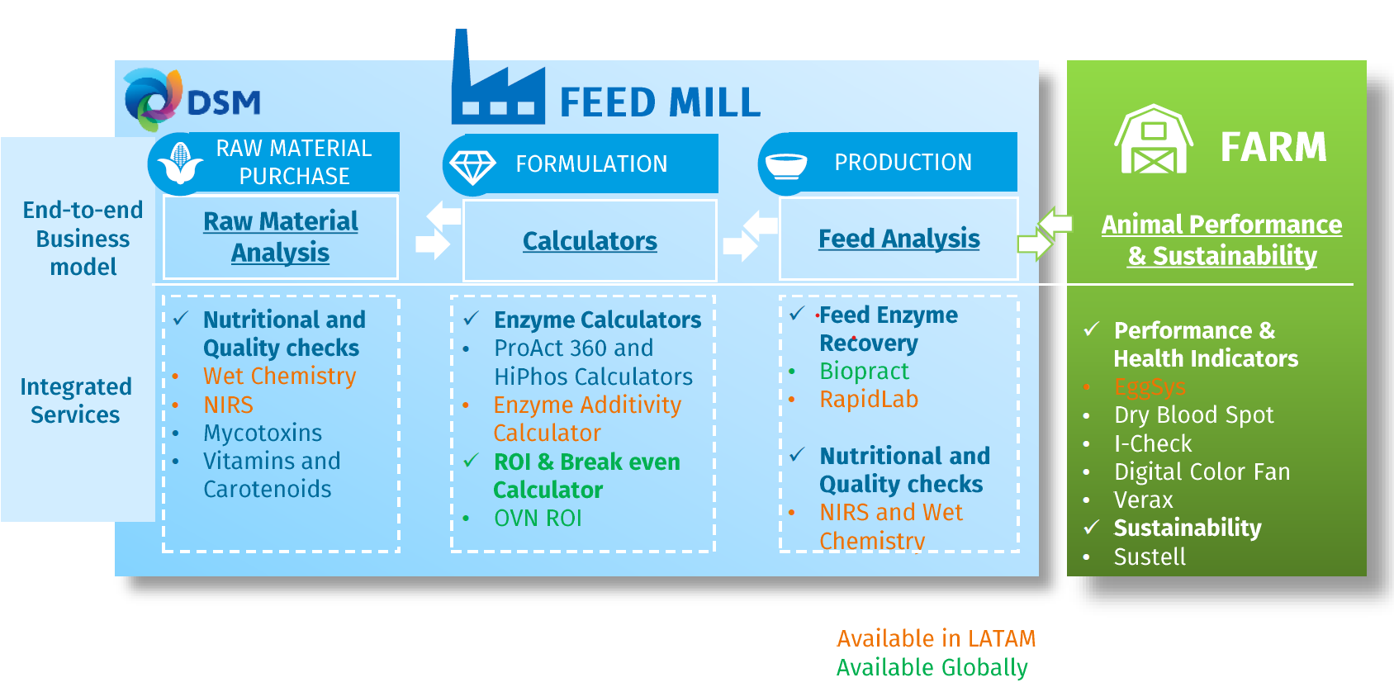
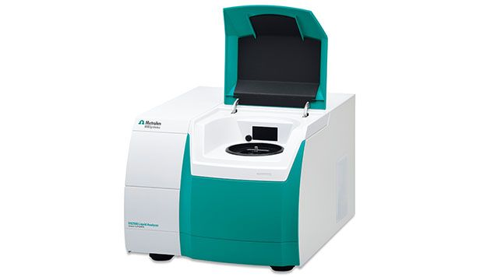
Services
Customer Portal

Slide 35
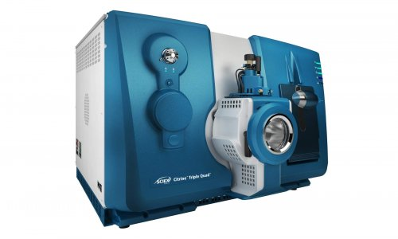
Services
Customer Portal

Slide 36
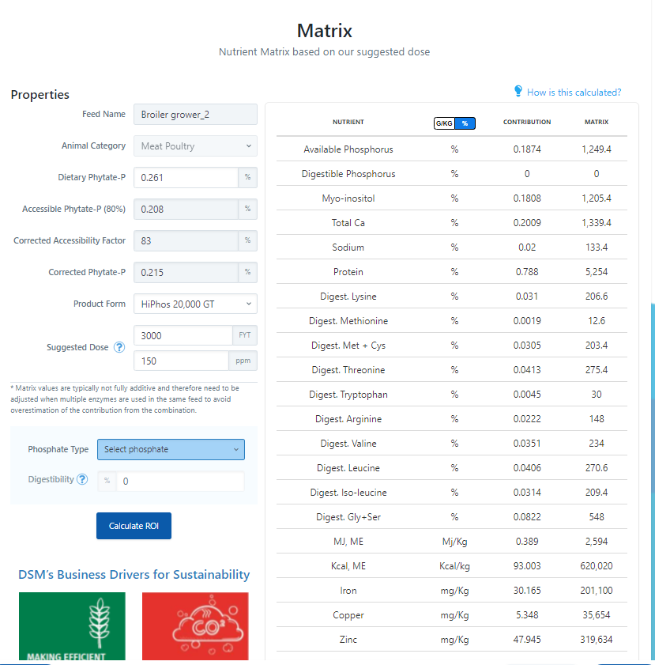
Services
Customer Portal

Slide 37
Services
Customer Portal

Slide 38
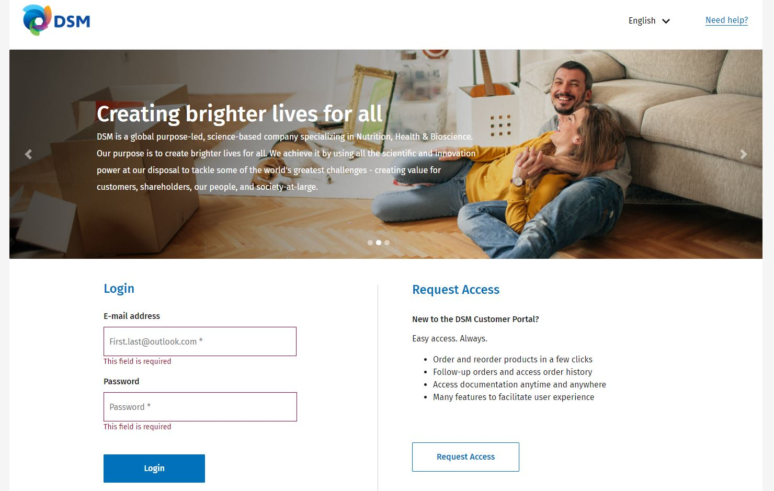
Services
Customer Portal

Slide 39
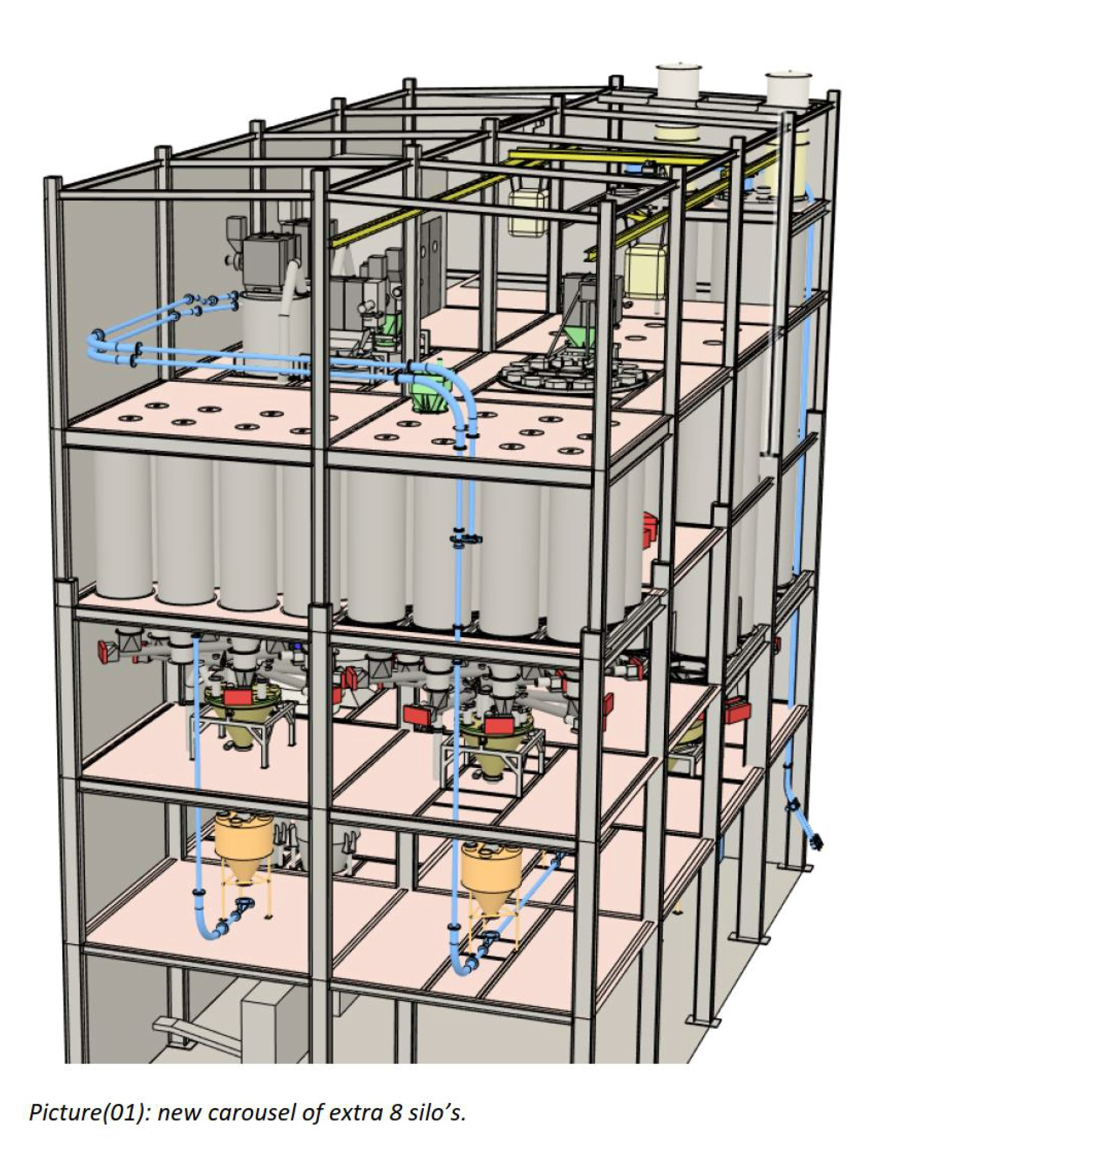
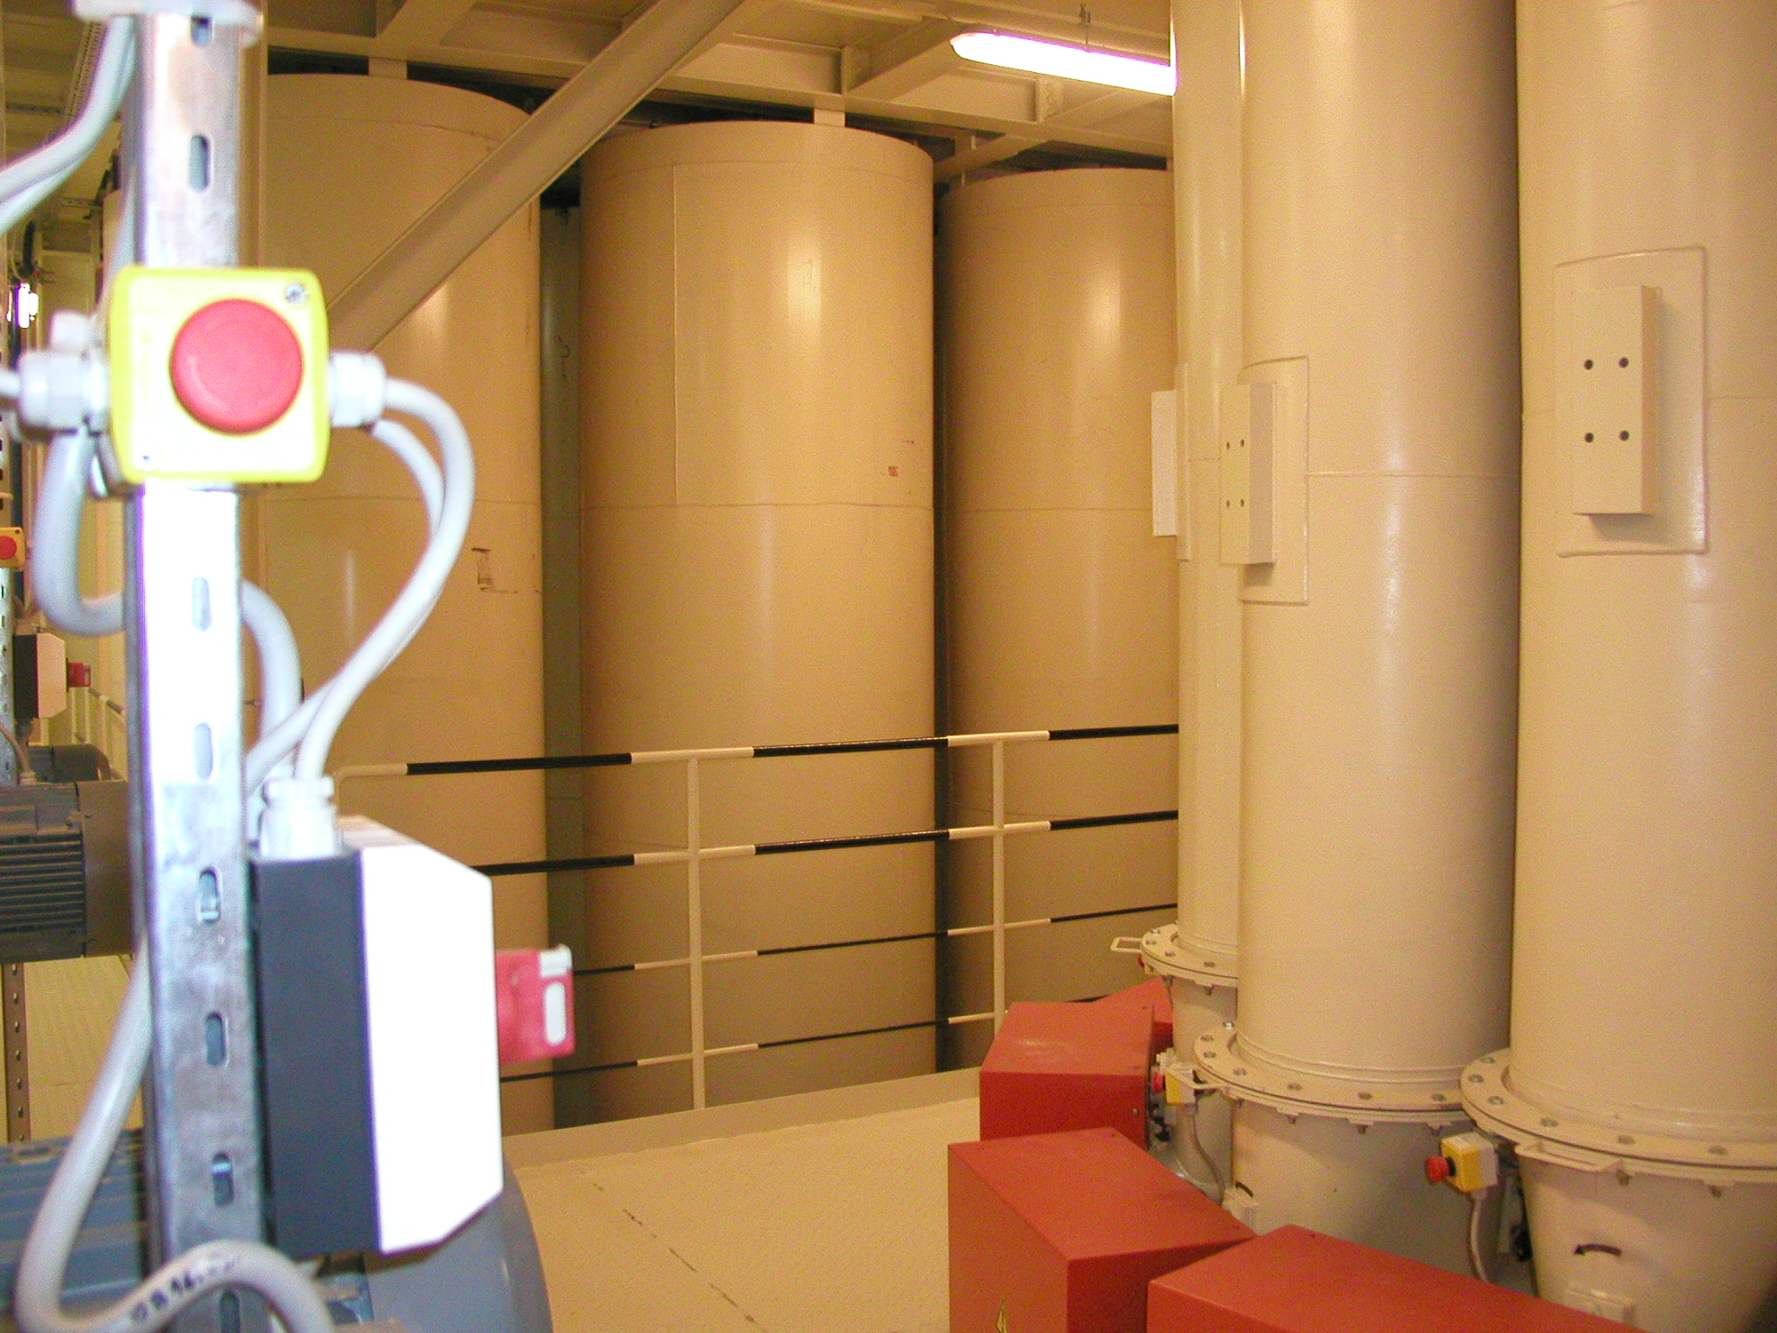

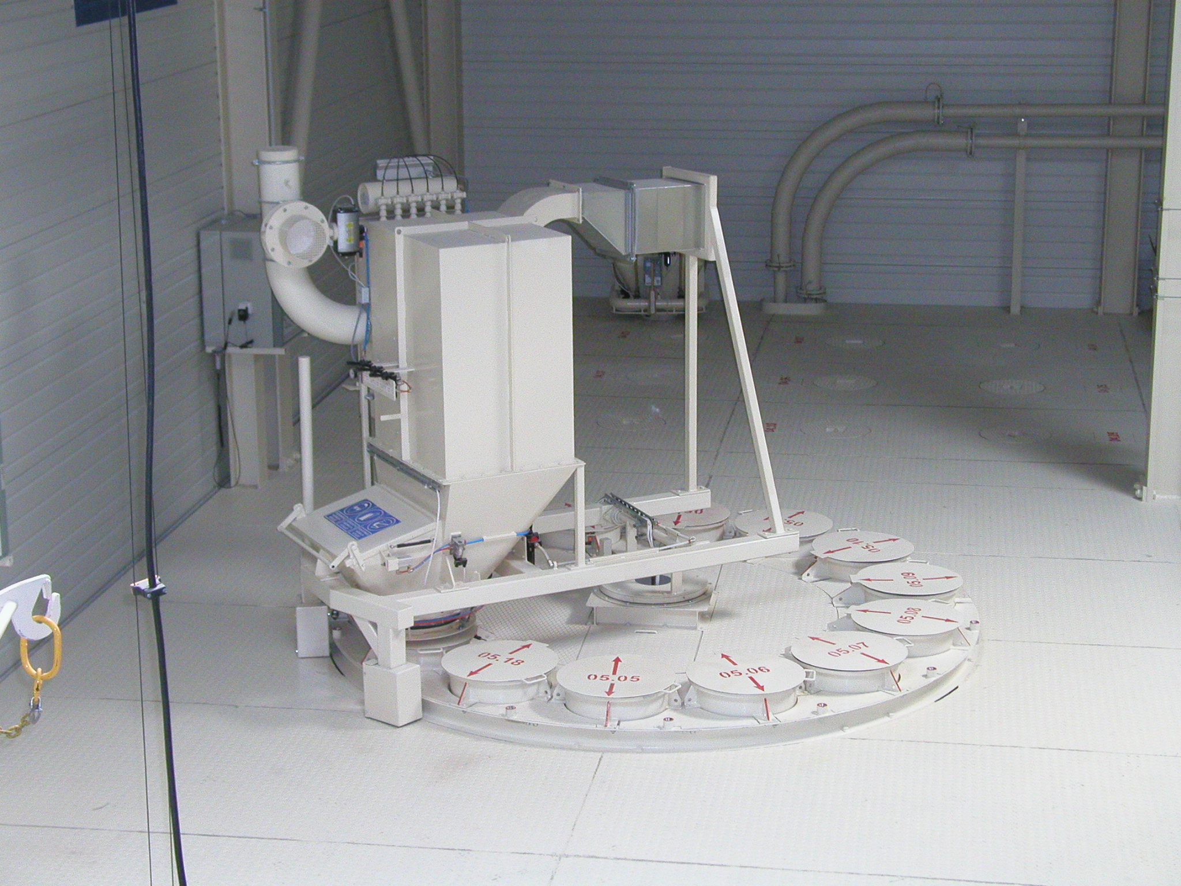
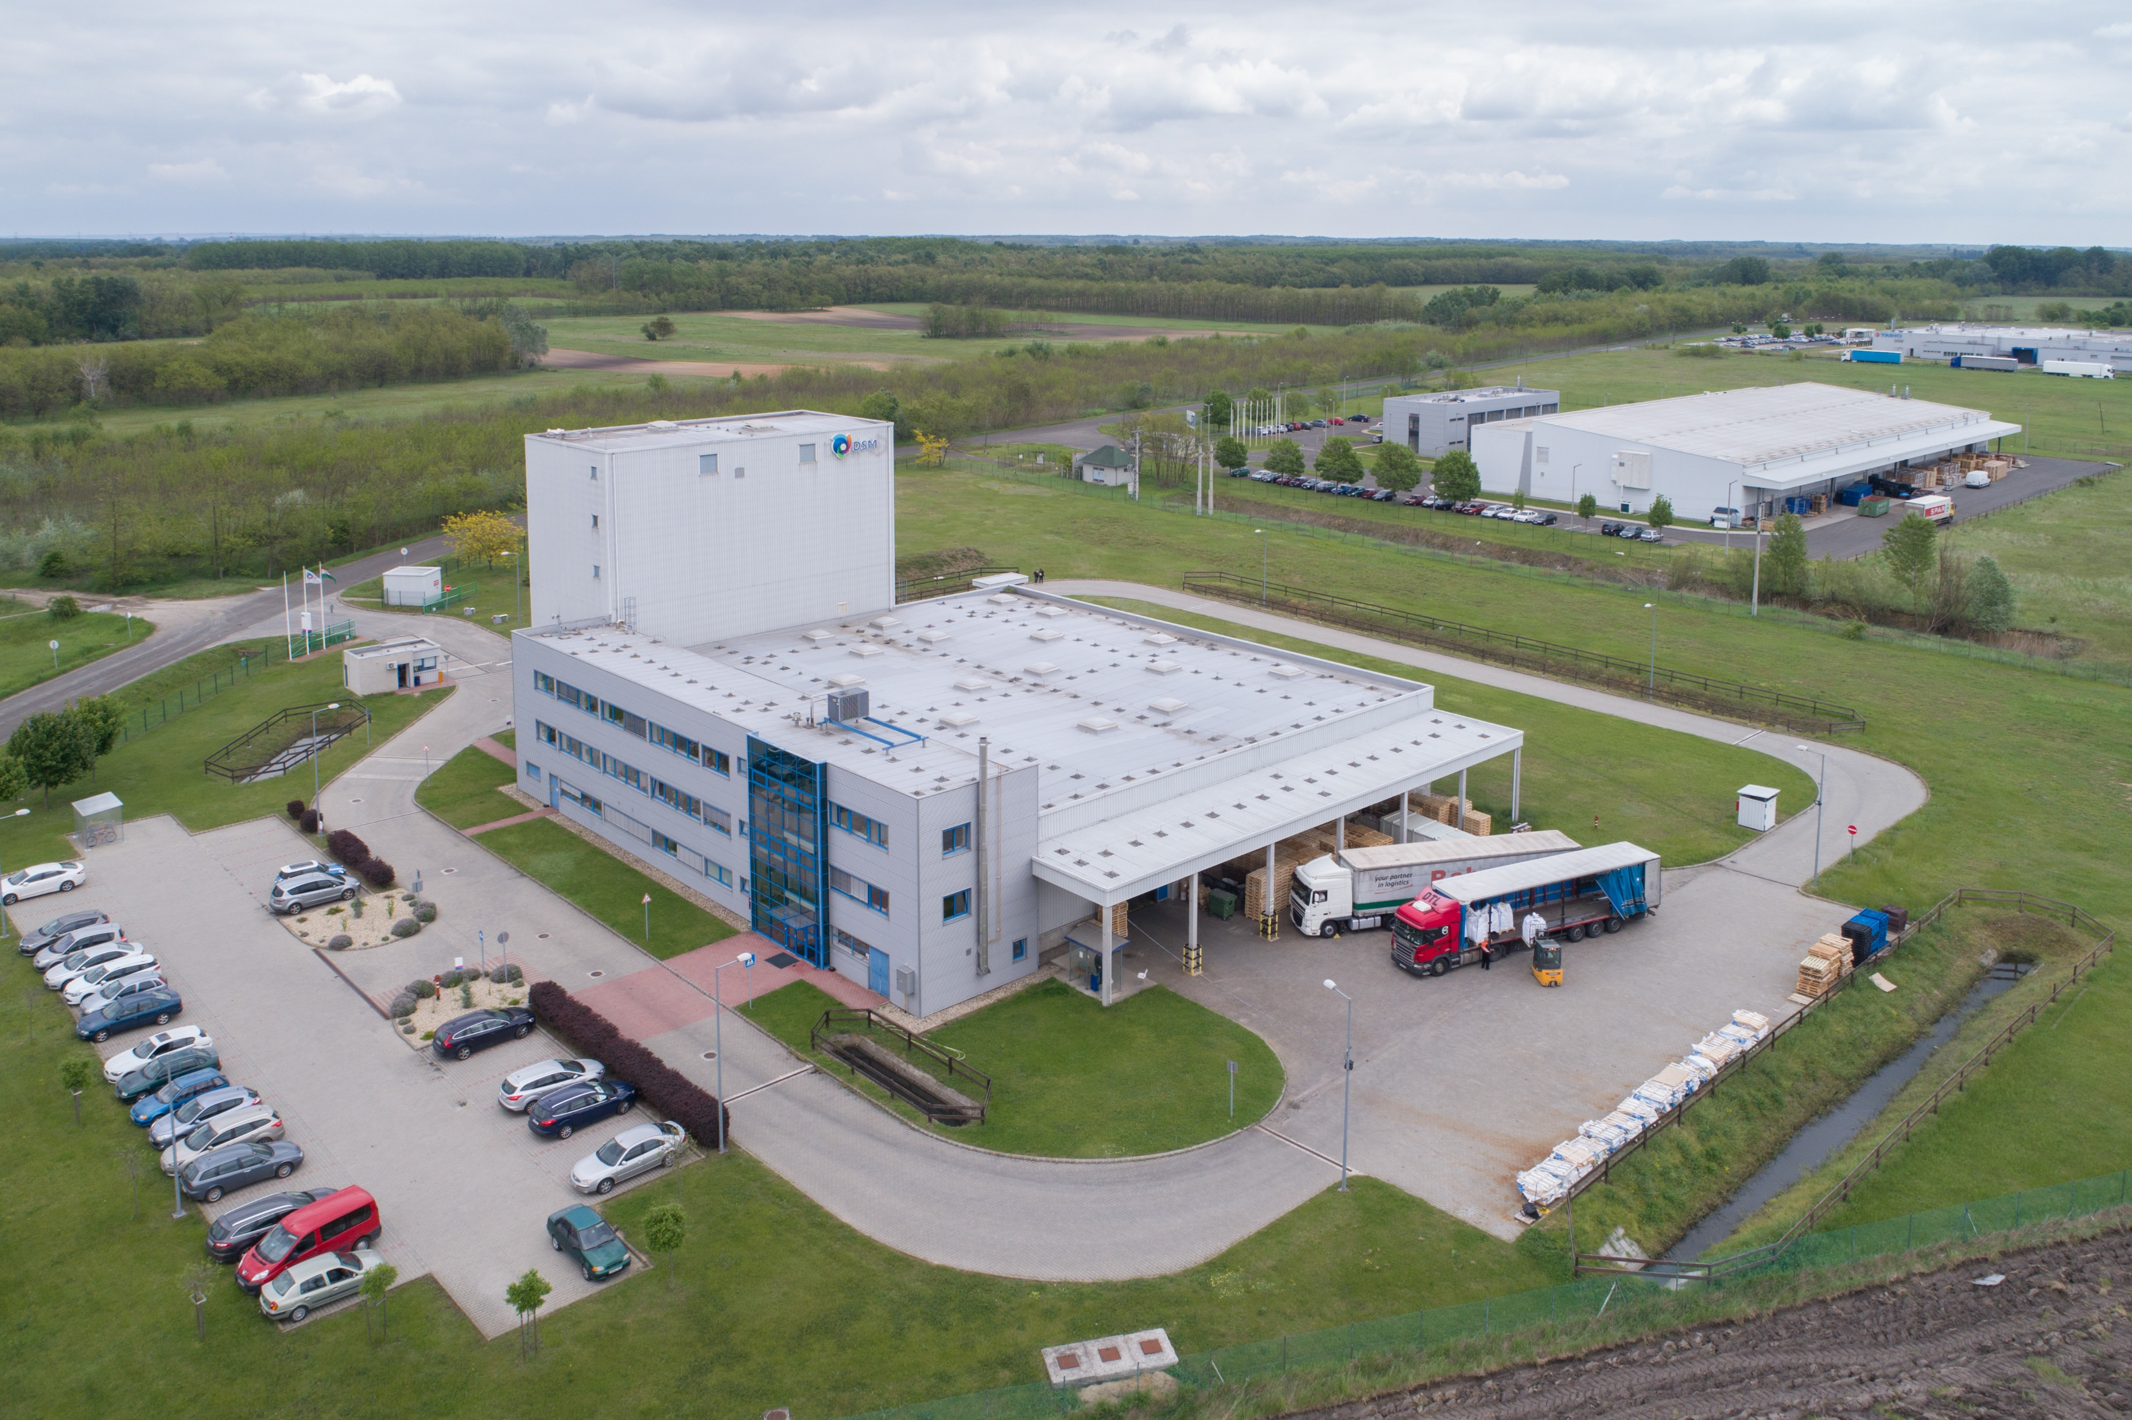
Premix plant technology upgrade – Project Danubia
Dispensary relocation
New group silo
Renewal of packaging line
New pneumatic system
Cover of loading area
Warehouse and production software
Security system upgrade
Solar panel park
New BB stations
Labor development

Slide 40


Slide 41
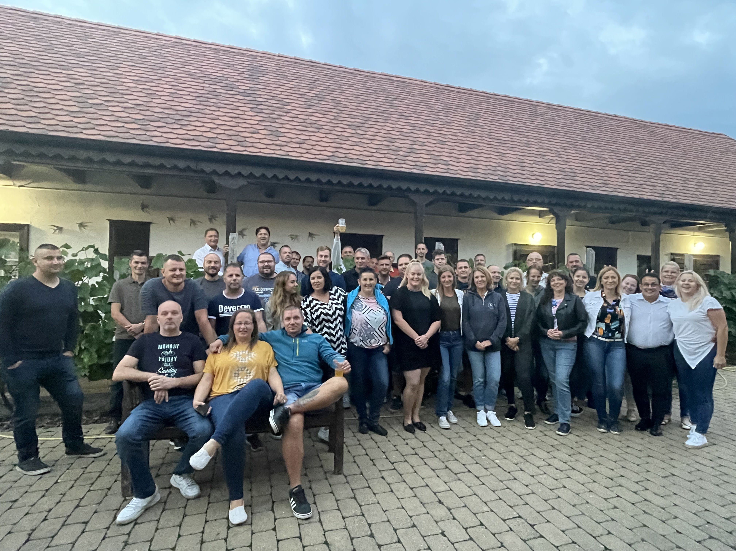

Slide 42

If not us, who? If not now, when?
WE MAKE IT POSSIBLE

